Slide 1


How to Collect, Stratify, and Display Data
PATIENT SAFETY
Using Quality Improvement and Safety Science to Eliminate Pregnancy-Related Racial and Ethnic Health Inequities
TOOLBOX
C Andrew Combs MD, PhD
Obstetrix, San Jose, California
SMFM
Rose Horton MSM, RN
Emory Decatur Hospital, Decatur, Georgia
AWHONN

Slide 2
Race and Ethnicity, US Census Bureau, in theory
Based on standards set by Office of Management & Budget, 1977 (OMB Directive 15)
Revised 1997
Race | Not Hispanic or Latino | Hispanic or Latino
White | NH White | Hispanic White
Black or African American | NH Black | Hispanic Black
Asian | NH Asian | Hispanic Asian
Am Indian or Alaska Native | NH AI/AN | Hispanic AI/AN
Native Hawaiian or Other Pacific Islander | NH NH/PI | Hispanic NH/PI
Some other race | NH Other | Hispanic Other
Federal Register 62 (210): 58782, 1997

Slide 3
Race vs Ethnicity
Race
  Concept historically emerged from European colonialism with purpose to discriminate, oppress, exploit
  Emphasis on observable physical differences
  More properly a social construct
Ethnicity
  Group that shares racial, national, tribal, religious, linguistic, or cultural origin or background
  Clearly a social construct
USPSTF, Lin et al, JAMA 326: 2412-2420, 2021

Slide 4
Race vs Ethnicity
Race
  Culturally-defined category base on physical characteristics such as hair texture, facial features, skin color
Ethnicity
  Category based on shared cultural practices that may include language, religion, or other customs
SMFM Special Statement, AJOG, April 2022

Slide 5
Race and Ethnicity, US Census Bureau, in theory
Based on standards set by Office of Management & Budget, 1997
Revised from OMB Directive 15: May 1977
Race | Not Hispanic or Latino | Hispanic or Latino
White | NH White | Hispanic White
Black or African American | NH Black | Hispanic Black
Asian | NH Asian | Hispanic Asian
Am Indian or Alaska Native | NH AI/AN | Hispanic AI/AN
Native Hawaiian or Other Pacific Islander | NH NH/PI | Hispanic NH/PI
Some other race | NH Other | Hispanic Other

Slide 6
Race and Ethnicity, US Census Bureau, as reported
Race/Ethnicity Group | Percent of US 2020 Population
Non-Hispanic White | 60.1%
Hispanic (Latino) | 18.5%
Non-Hispanic Black or African American | 13.4%
Non-Hispanic Asian | 5.9%
Non-Hispanic American Indian or Alaska Native | 1.3%
Non-Hispanic Native Hawaiian or Other Pacific Islander | 0.2%
Some other race | n/r (14.8%)
Multiracial | 2.8%
https://www.census.gov/quickfacts/US

Slide 7
Bad Habits that Die Hard
Two extra weeks added to gestational age
Premature rupture of membranes (instead of “prelabor”)
Pareto chart

Slide 8
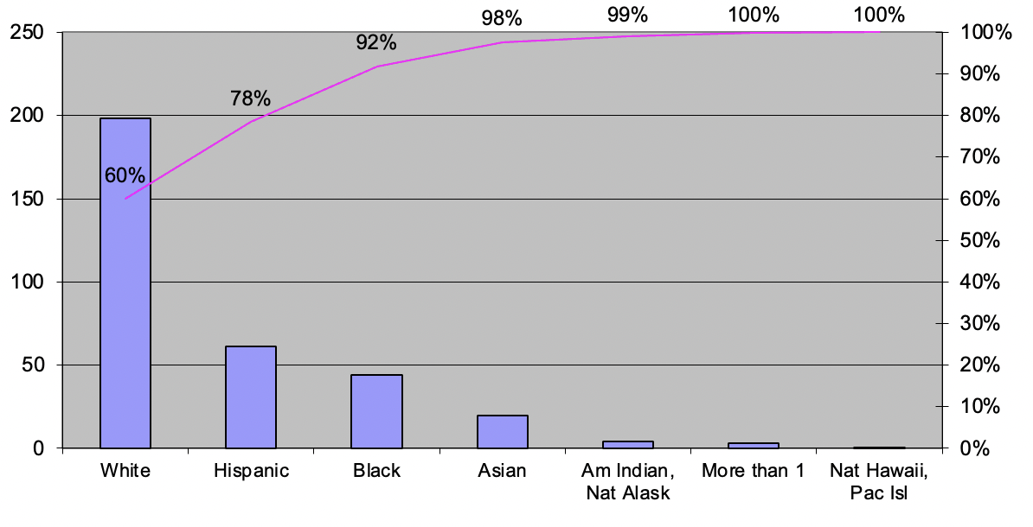
Pareto Chart – US Census 2020
Population in Millions

Slide 9
Pie Chart – US Census 2020

Slide 10
Reporting Race – US Preventive Services Task Force
Race and ethnicity are self-reported
Avoid using race names as nouns (e.g., Blacks have higher MMR)
  Use them as adjectives (e.g., Black people have higher MMR)
Avoid non-parallel comparisons (e.g. White vs African American)
  Use parallel comparisons instead (e.g. White vs Black)
Use Latino, Latina, or Latinx in preference to Hispanic (controversial)
Use White in preference to Caucasian
Use Am Psychol Assn terminology for Asian people (Asian American) and native people (e.g. Alaska Native)
USPSTF JAMA 326: 2405-2411, 2021
Lin et al JAMA 326: 2412-2420, 2021

Slide 11
Self-Report ?
Hospital
N = 8,066
1 month
Office
N = 77,568
5 years

Slide 12
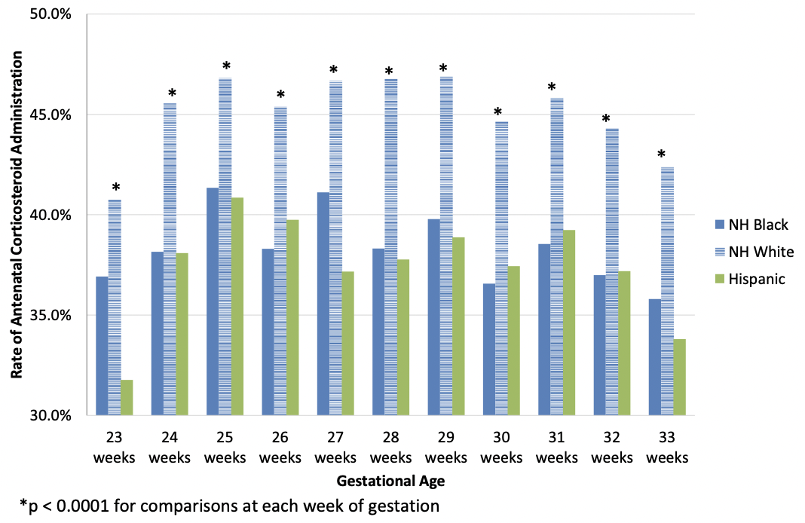
Adjustment vs Stratification
Antenatal Steroids Before PTB
NH-White (referent)
NH-Black aOR 0.83 (0.81-0.85)
Hispanic aOR 0.80 (0.78-0.83)
Adjusted for maternal age, nulliparity, marital status, education, insurance, prenatal care, diabetes, hx of PTB, tobacco, infertility, cesarean delivery
Data and figure from:
Grunebaum et al, Am J Ob/Gyn 223: 933-934, 2020

Slide 13
Stratification
Grunebaum et al, Am J Ob/Gyn 223: 933-934, 2020

Slide 14
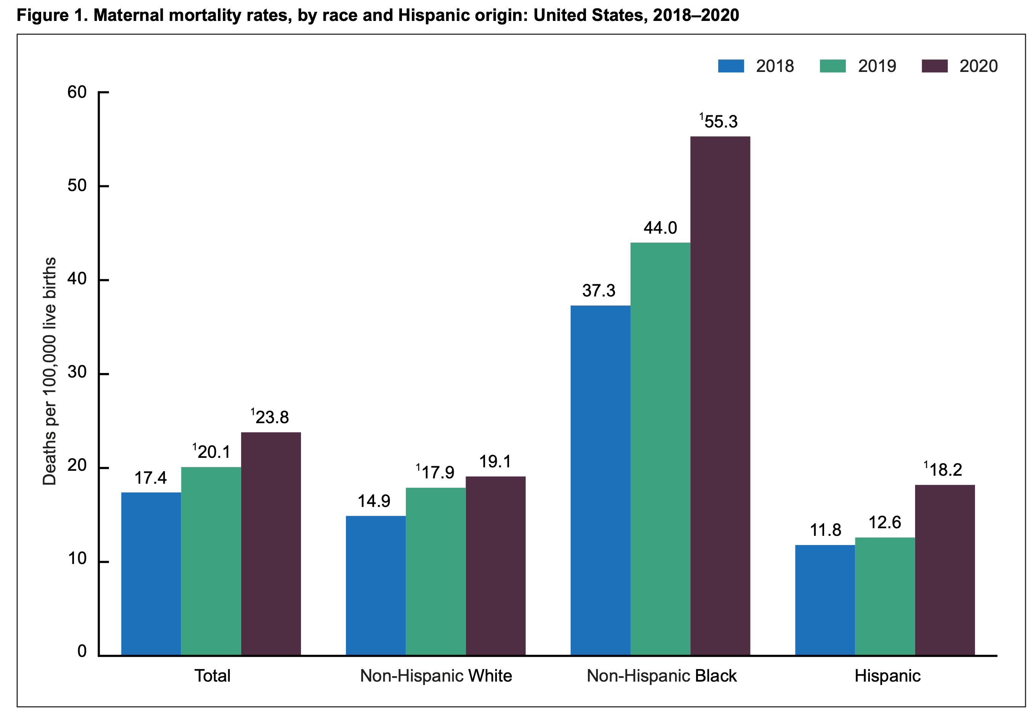
Stratification, Temporal Trends
www.cdc.gov/nchs/data/hestat/maternal-mortality/2020/E-stat-Maternal-Mortality-Rates-2022.pdf

Slide 15
Run Chart
Plotted from data in: Peterson et al, MMWR 68: 762-765, 2019
and
www.cdc.gov/nchs/data/hestat/maternal-mortality/2020/E-stat-Maternal-Mortality-Rates-2022.pdf

Slide 16
Control Chart

Slide 17
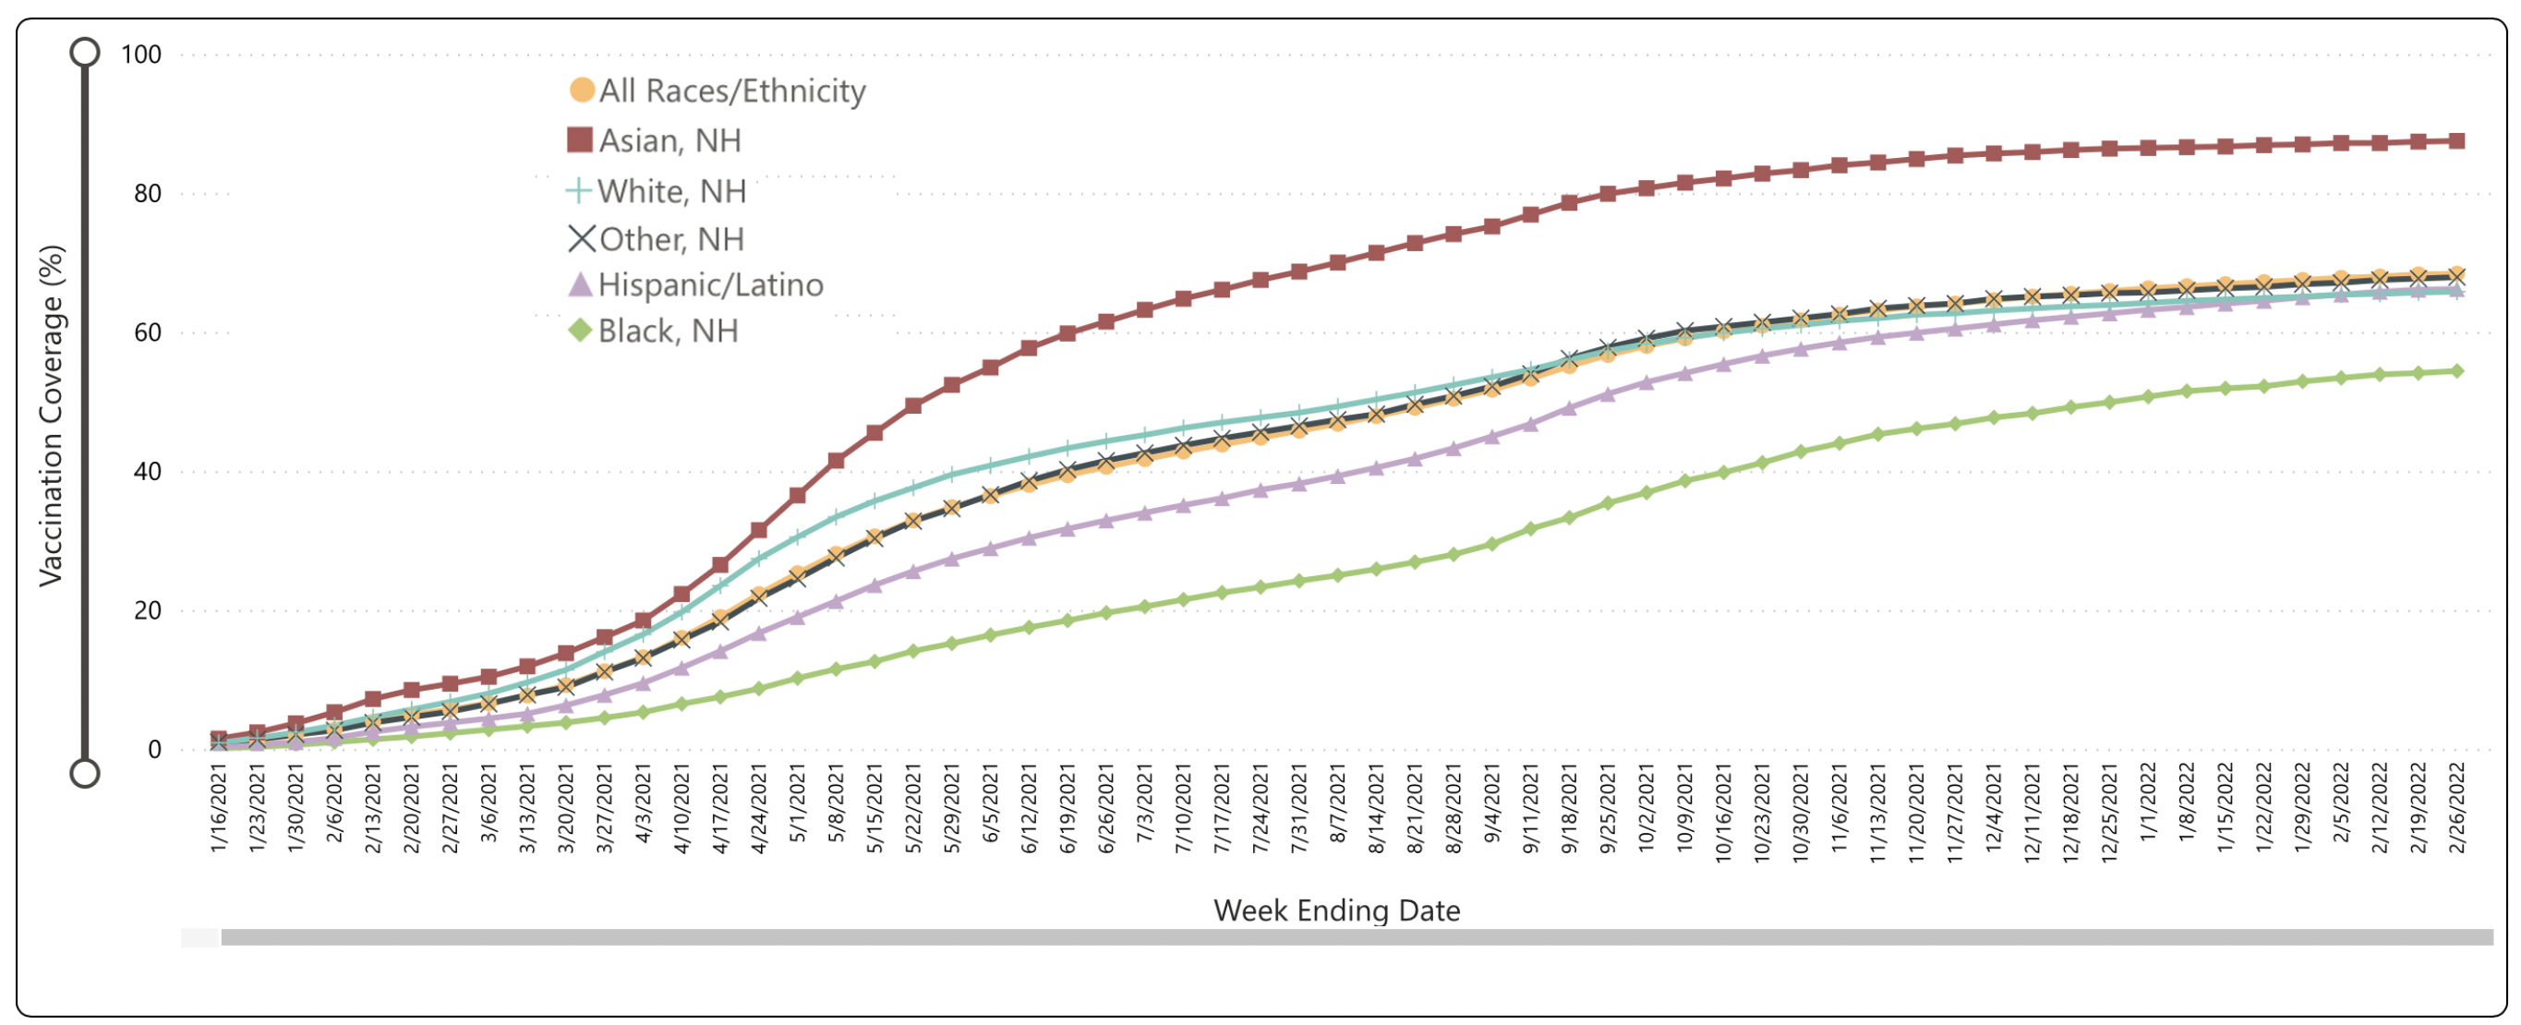
Cumulative Frequency Chart
covid.cdc.gov/covid-data-tracker/#vaccinations-pregnant-women

Slide 18
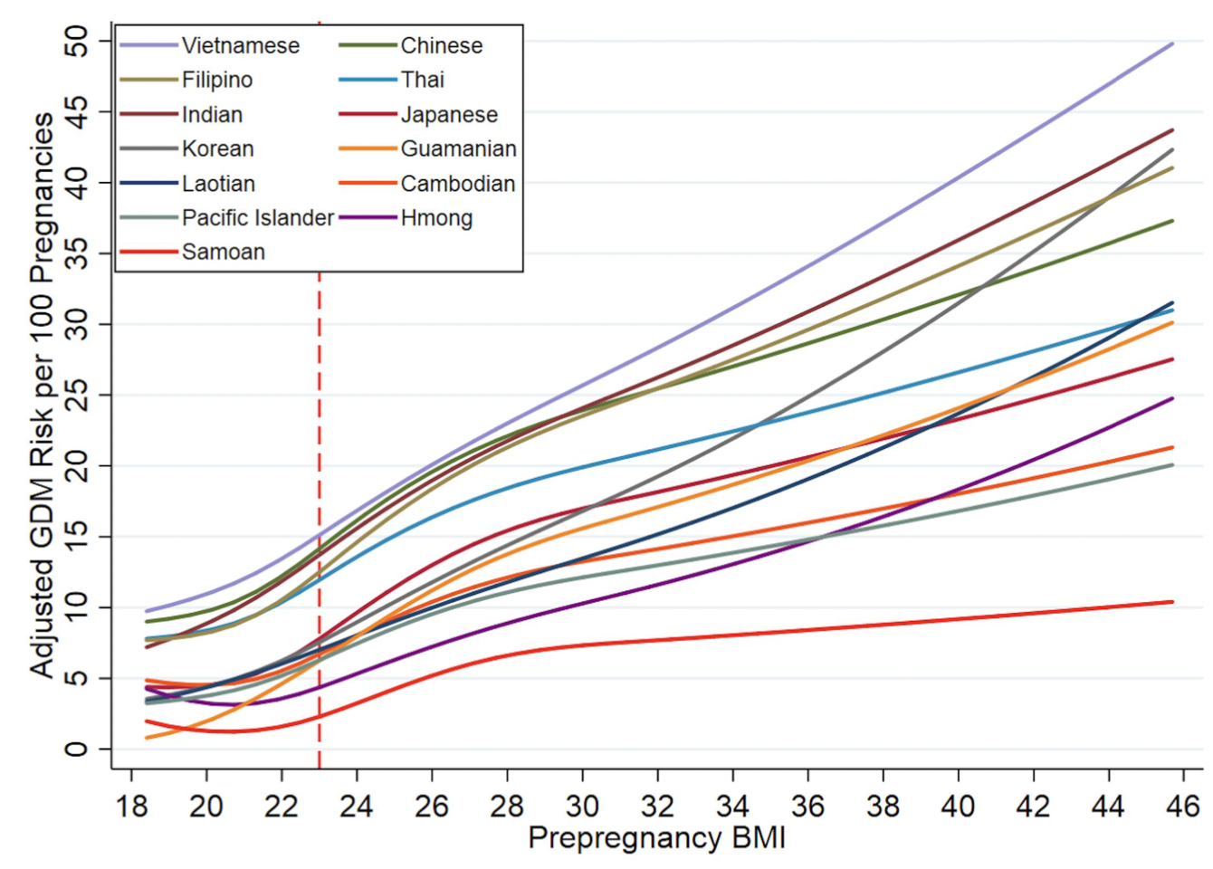
Sub-Stratification
Sperling, data presented at Pacific Coast Ob Gyn Society, 2021

Slide 19
Stratification by Maternal and Paternal Race
Maternal | Paternal | Preterm Birth <28 wks Adjusted Odds Ratio [95% CI]
White | White | 1 (referent)
White | Black | 1.66 [1.45-1.92]
Black | White | 3.41 [2.93-3.97]
Black | Black | 4.22 [4.04-4.41]
Adjusted for prior PTB, CHTN, smoking, fetal sex
Green et al, AJOG MFM 3:100353, 2021

Slide 20
Race & Ethnicity – AMA Manual of Style
Although race and ethnicity have no biological meaning, the terms have important, albeit contested, social meanings.
Neglecting to report race and ethnicity in health and medical research disregards the reality of social stratification, injustices, and inequities and implications for population health.
Removing race and ethnicity from research may conceal health disparities.
Thus, inclusion of race and ethnicity in reports of medical research to address and further elucidate health disparities and inequities remains important at this time.
AMA Manual of Style Committee
JAMA 326: 620-627, 2021

Slide 21

Who We Are
Emory Decatur Hospital
~3500 births/year
Level III NICU
Baby Friendly Designated Facility (since 2014)

Slide 22
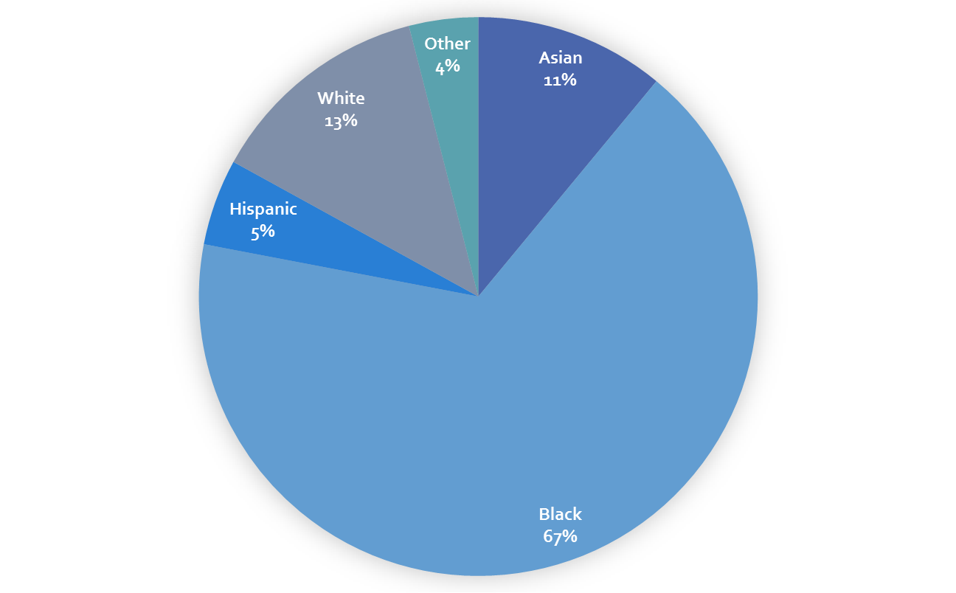
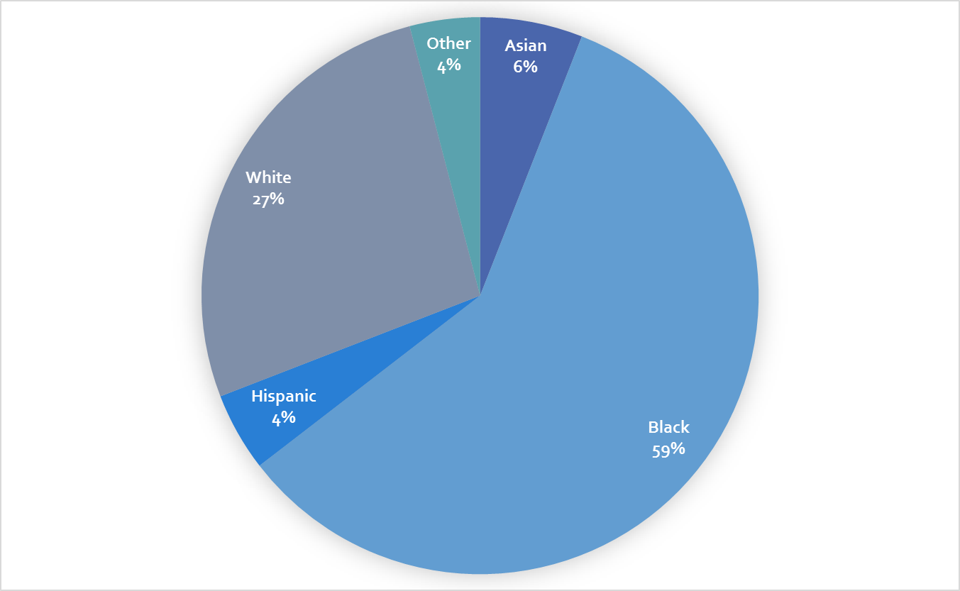
Our Patients
Our Staff
Women & Infant Services
Staff Population
Patient Population

Slide 23
“Women are not dying because of untreatable diseases. They are dying because societies have yet to make the decision that their lives are worth saving: We have not yet valued women’s lives and health highly enough.”
Mahmoud F. Fathalla, MD Secretary General

Slide 24
“Nothing Protects Black Women From Dying in Pregnancy and Childbirth
Not education. Not income. Not even being an expert on racial disparities in health care”
ProPublica 12/7/2017
A Black woman is 22% more likely to die from heart disease, 71% more likely to perish from cervical cancer, but 243% more likely to die from pregnancy- or childbirth-related causes.
In a national study of five medical complications that are common causes of maternal death and injury, Black women were two to three times more likely to die than women of all races who had the same condition.
A 2016 analysis of five years of data found that Black college-educated mothers (in New York City) who gave birth in local hospitals were more likely to suffer severe complications of pregnancy or childbirth than white women who never graduated from high school.
In New York City, Black mothers are 12 times more likely to die than white mothers
Shalon Irving
Kira Dixon-Johnson
Darlene Dominguez-Hicks
Nicole Thea

Slide 25
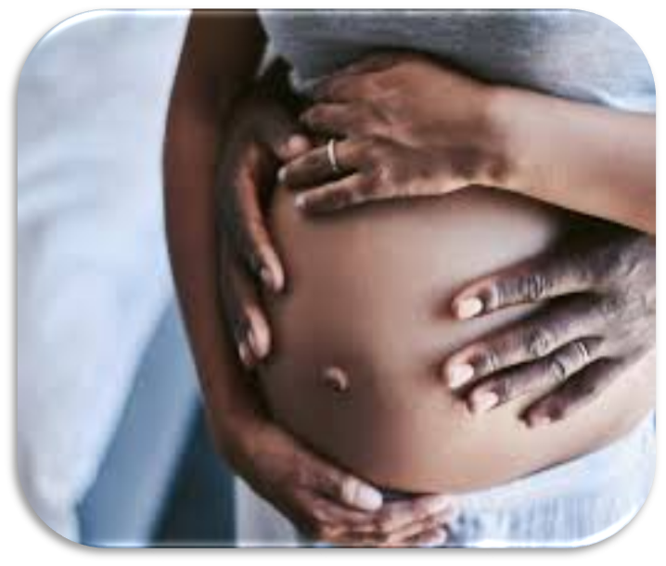
Race is not a risk factor.
Racism is.
-DR JOIA ADELE CREAR-PERRY, MD, FACOG

Slide 26
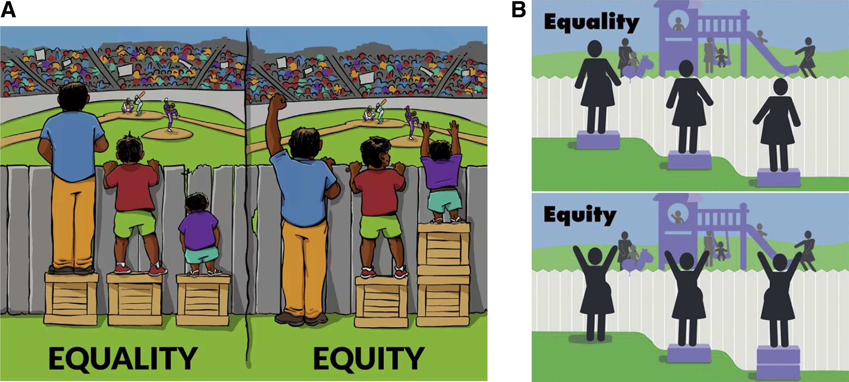
Two Conceptualizations of Equality vs Equity
MadeWithAngus.com
SMFM Special Statement, AJOG, April 2022
Notes:
Rose – consider using this one instead of the bicycle one – I will explain on phone call

Slide 27
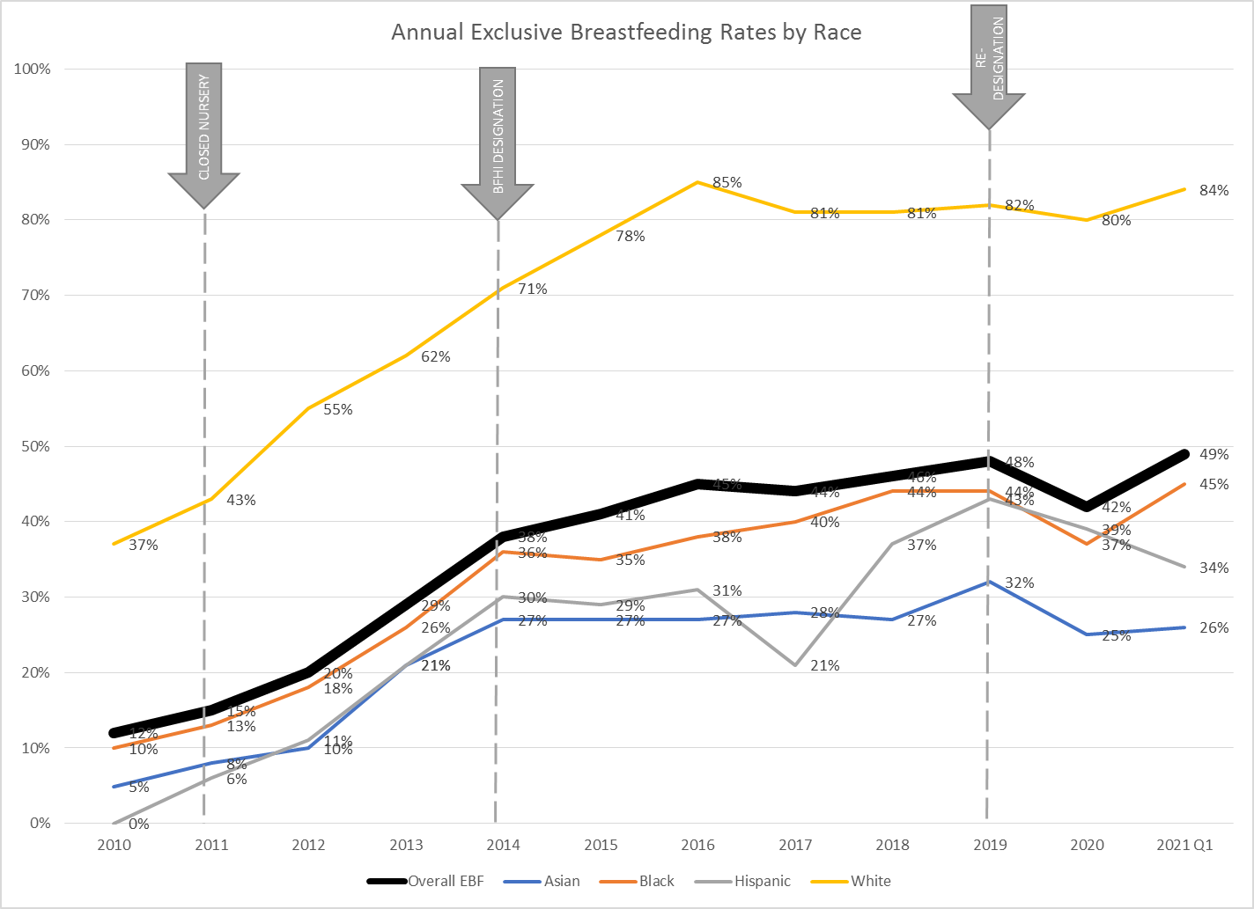
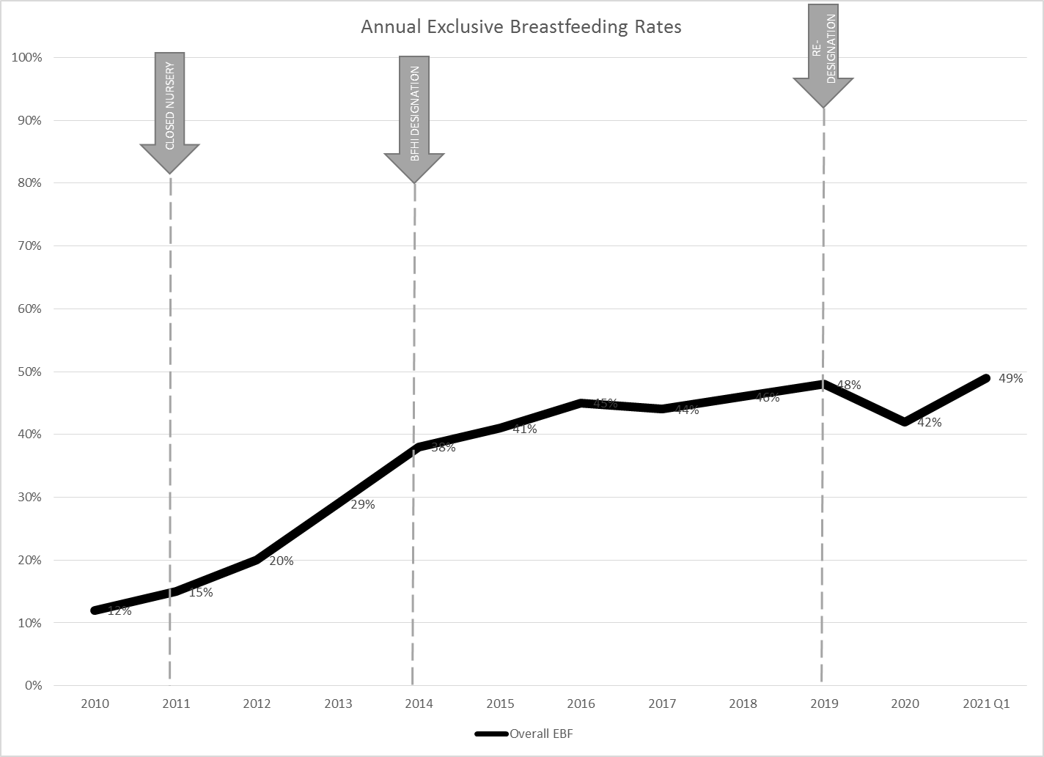
Exclusive Breastfeeding Rates
Notes:
Should this be “exclusive breast-milk feeding rates”?

Slide 28
Exclusive Breastfeeding Rates
Notes:
Consider ADDING this after slide 29 – will discuss on call

Slide 29
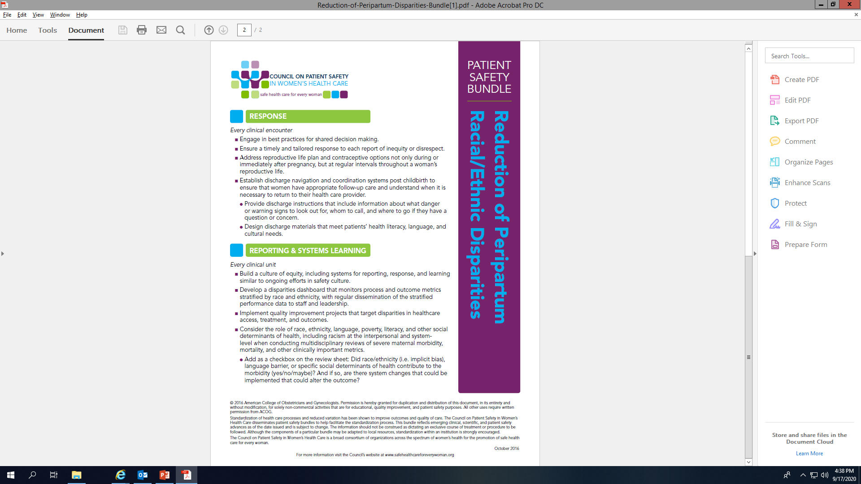
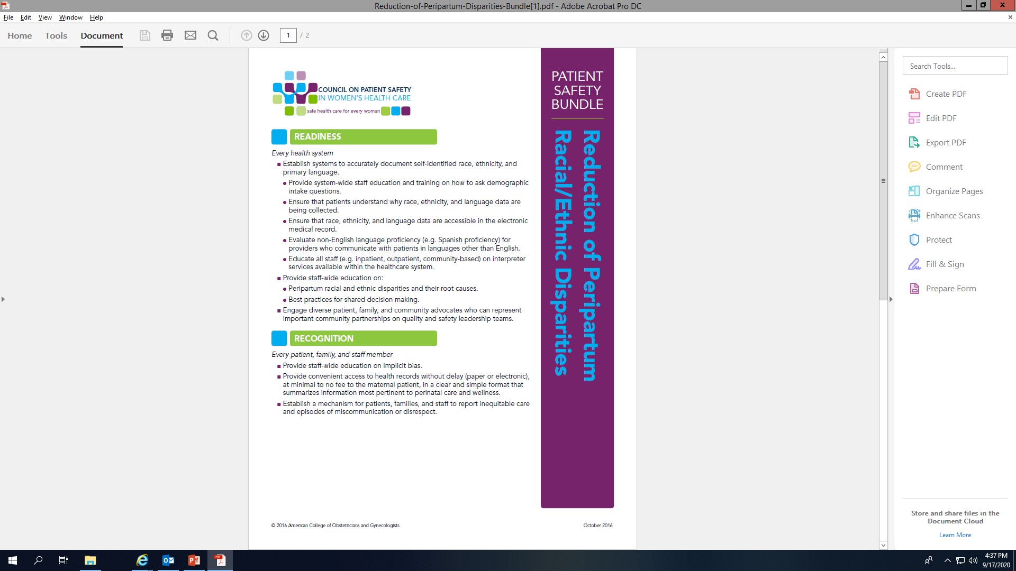

Slide 30
Metric Selection
Ease of Collection
Current & Historical Availability
Value to Stakeholders
Sphere of Influence
Data Relevance
Sample size
Benchmark & Comparable Data

Slide 32
Human Milk Feeding & Language
Race | English/Language | Other/Language
White | 85% | N/A
Black | 67% | 47%
Asian | 73% | 50%
Hispanic | 72% | 63%

Slide 33
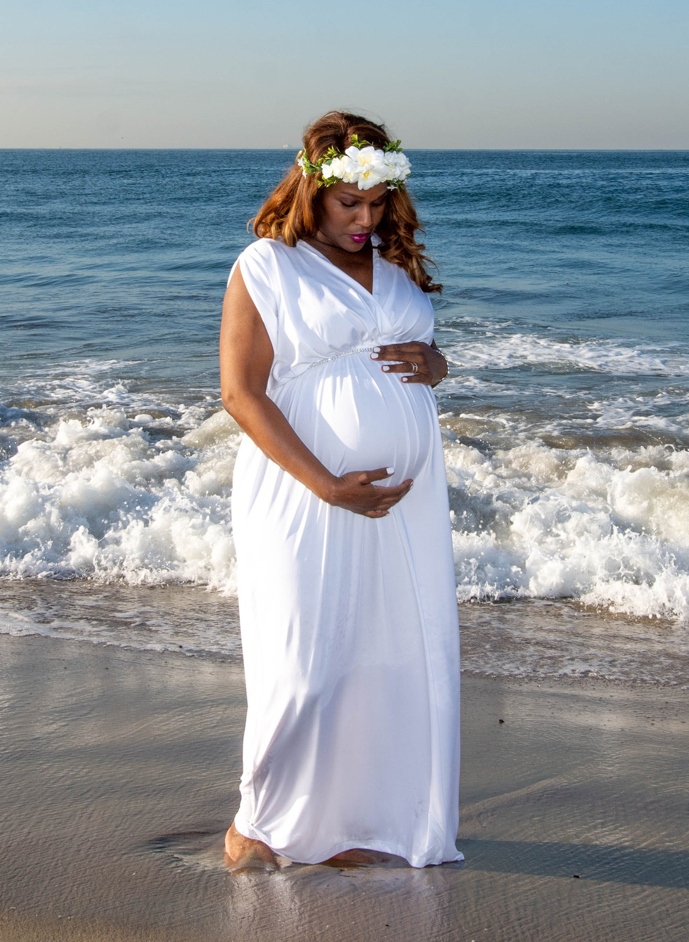

Slide 34
Disparity Data Porn
“The emphasis on utilizing and disseminating perinatal disparity data as the call to action without a serious interrogation of the driving factors
for disparate perinatal care, outcomes, and experiences,
particularly within hospital health systems
AND among Black mothers and birthing people,
further perpetuates the structural racism in mother blame narratives.”
Dr Karen A. Scott, 2019

Slide 35


