Slide 1
Counseling Pregnant Patients Regarding Respiratory Syncytial Virus and Immunization
Naima T. Joseph MD, MPH Maternal-Fetal Medicine Specialist
Boston Medical Center
Brenna Hughes, MD, MSc Maternal-Fetal Medicine Specialist
Duke Medicine

Slide 2
Introduction
Respiratory Syncytial Virus (RSV) is a leading cause of respiratory morbidity in infants
Two new immunization products (a maternal vaccine and an infant monoclonal antibody) have been recommended by the Center for Disease Control and Prevention’s (CDC) Advisory Committee on Immunization Practices (ACIP)
All infants should be protected using one of these products
This presentation summarizes recently published SMFM guidance to assist Maternal Fetal Medicine specialists and all prenatal care providers counsel their patients regarding infant protection against RSV
SMFM. Am J Obstet Gynecol. 2023
Notes:
oseph NT, Kuller JA, Louis JM, Hughes BL. Society for Maternal-Fetal Medicine Statement: Clinical considerations for the prevention of respiratory syncytial virus disease in infants. Am J Obstet Gynecol. 2023

Slide 3
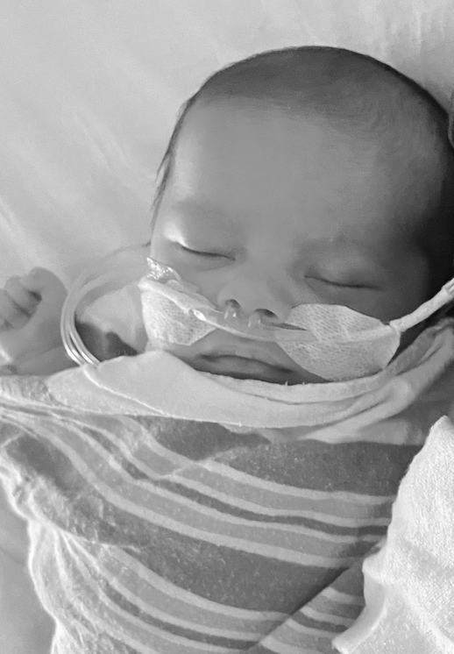
Burden of RSV in infants
The leading cause of respiratory disease and hospitalization in infants and children¹
US burden:
68% of infants infected in the first year of life and 97% by second year
2 -3% will be hospitalized due to RSV
Highest proportion of hospitalizations and deaths in infants < 6 months
Risk Factors²
Prematurity, chronic conditions (e.g. congenital heart disease, lung disease)
66% of infants have no underlying high-risk conditions
¹Am Acad Ped. Red Book, 32nd Edition.; ² Hall C. New Engl J Med. 2009
Notes:
RSV causes severe respiratory illness in more than 50,000 children each year; it may be life-threatening for infants from birth to 6 months.

Slide 4
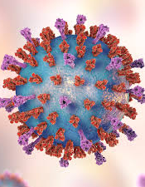
What is Respiratory Syncytial Virus?
ssRNA virus, Pneumoviridae
Subgroups A and B
Cocirculate each season
Transmission
Respiratory droplets
Fomites
Aerosolized droplets rare
Season
Continental US: mid-September – April
Tropical climates and Alaska, longer, less predictable
Changes observed during COVID-19 pandemic
Symptoms
Rhinorrhea, pharyngitis, cough, headache, fever
Irritability, decreased activity or oral intake, increased work of breathing in infants

Slide 5
Rationale for passive immunization
Whole Inactivated RSV Vaccine Trial, 1960s
Modeled after the whole inactivated polio vaccine developed by Salk
Youngest cohort immunized before 6 months
Winter of 1967 – 1966, outbreak of RSV in the youngest vaccinated group
Excess of 20 infections, 18 hospitalizations, 2 deaths, compared to the comparator group¹
Demonstrated inability to vaccinate infants directly
Immunization during pregnancy confers known advantage against infant infection through transplacental transfer (e.g. tetanus, pertussis, influenza, COVID-19)
Passive immunization with palivizumab beneficial but not cost effective unless given to high-risk infants
Failures around cost, burden of administration²
¹Kim HW. Am J Epidemiol.1969;
²Venkatesen P. Lancet Microbe. 2022

Slide 6
What is Abrysvo?
Bivalent RSV Prefusion vaccine manufactured by Pfizer approved for the prevention of RSV disease in infants up to 6 months of age
Given to pregnant people from 32 0/7 weeks to 36 6/7 weeks gestation
Given only during RSV season (September – January in most of the continental United States)
Single IM injection
Reduces the risk of severe RSV disease and hospitalization up to 6 months in > 77% of vaccine recipients
Safe
Most common side effect is local injection site pain (40%)
Low risk of serious adverse effects or allergic reaction

Slide 7
MATISSE Trial
Multi-country, multi-site, placebo-controlled, phase 3 double-blind, randomized controlled trial
Efficacy outcomes: severe medically-attended RSV –associated lower respiratory tract infection in infants defined as
Moderate-severe tachypnea
SpO2 measured on room air <93%
High-flow nasal cannula or mechanical ventilation
ICU admission >=4 hours
Unconscious or unresponsive
RSVpreF vaccine associated with 69.4% (97.58%CI 44.3 – 84.1) efficacy at 180 days
Kampmann B. New Engl J Med. 2023

Slide 8
Birth outcomes in maternal vaccine trial
Event Type | RSV PreF 120ug | Placebo
Maternal Death | <0.1% (n=1) | 0
Preeclampsia | 1.8% | 1.4%
Fetal death or stillbirth | 0.3% | 0.2%
Infant death | 0.1% | 0.3%
Preterm birth | 5.7% | 4.7%
Kampmann B. New Engl J Med. 2023

Slide 9
Trial dosing interval vs. licensed/ approved dosing interval
On August 21, 2023, the Food and Drug Administration approved the Pfizer RSVpreF vaccine for use in pregnant people as a single dose to be given at 32 through 36 weeks gestation
In the clinical trials, participants were enrolled, and vaccines were administered from 24 through 36 weeks gestation
FDA approval window to mitigate the observed imbalance in preterm birth
In US Trial participants enrolled in the approved dosing interval, the preterm birth rate occurred in 4.0% of RSV PreF Vaccine recipients group and 4.4% of placebo recipients
ACIP Presentation Slides: September 2023 Meeting

Slide 10
Efficacy against severe, medically-attended RSV-associated LRTI: trial dosing vs approved dosing
Time period after birth | Trial dosing interval (24-36 weeks gestation) Vaccine efficacy (99.5% or 97.58% Cl) | Approved dosing interval (32-36 weeks gestation) Vaccine efficacy (95% Cl)
0-90 days after birth | 81.8% (40.6, 96.3) | 91.1% (38.8, 99.8)
0-180 days after birth | 69.4% (44.3, 84.1) | 76.5% (41.3, 92.1)
ACIP Presentation Slides: September 2023 Meeting

Slide 11
What is Nirsevimab?
Monoclonal antibody directed against the RSV F protein, marketed as Beyfortus
Given to infants up to 8 months born during or entering their first RSV season
Given to infants with high-risk conditions up to 19 months entering their second RSV season
RSV season for administration is October – March in most of the continental United States
Single IM injection
Reduces the risk of severe RSV by 80% in recipients
Safe
< 1.5% of infants will have a reaction such as rash or pain
Simões. EAF. Lancet Child Ad Health. 2023

Slide 12
CDC Alert Regarding Nirsevimab Shortage

Slide 13
Recommendations for infant RSV Prevention
All infants should be protected against RSV using one of two products
The bivalent RSVpreF vaccine is recommended to be administered as a one-time dose, using seasonal administration to pregnant persons between 32 0/7 and 36 6/7 weeks gestational age
Seasonal administration is end of September through end of January in most of the continental United States
Either maternal RSVpreF vaccination or nirsevimab administration to the infant is recommended
With few exceptions, most infants will not need both
Fleming-Dutra KE. MMWR. 2023

Slide 14
RSV PreF Vaccine Recommendations for birthing people
Can be administered to all birthing persons between 32 0/7 – 36 6/7 weeks
Should be administered seasonally (October – end of January)
Can be co-administered with other routine vaccine products in pregnancy (Tdap, COVID-19, influenza)
Patients should be counseled regarding safety, efficacy, and uncertainty regarding preterm birth (that an imbalance was seen in low- and middle-income countries, not observed within US trial participants, and not observed within the approval dosing window)
Patients should be counseled regarding the option for nirsevimab in the context of availability and cost
Providers should ensure that birthing patients are receiving the RSV vaccine made by PFIZER and not GSK
Fleming-Dutra KE. MMWR. 2023

Slide 15
Nirsevimab monoclonal antibody recommendations for infants
Nirsevimab is recommended in the following scenarios:
Infants whose birthing parent who either did not receive RSV preF vaccine or whose vaccine history is not known.
Birthing parent vaccinated within 14 days of delivery.
Infants and children aged 8 – 19 months at increased risk for severe RSV disease and entering their second RSV season, irrespective of birthing parent vaccine status.
Nirsevimab may be considered for:
Maternal conditions resulting in inadequate immune response and/or decrease in transplacental transfer (i.e., infants born to pregnant people with chronic immunosuppression with anticipated diminished immune responses to vaccination (organ transplant, chronic steroid use)
Infants with loss of maternal antibodies (i.e., those who have undergone cardiopulmonary bypass or extracorporeal membrane oxygenation)
Infants with substantially increased risk for severe RSV disease (i.e., hemodynamically significant congenital heart disease)
Jones J. MMWR. 2023

Slide 16
Choosing an RSV infant prevention product
 | RSVPreF Maternal Vaccine (Abrysvo) | Monoclonal Antibody (Nirsevimab)
Benefits | Provides immediate protection after birth (if maternal vaccination occurred >14 days before birth) Maternal vaccination results in a polyclonal response, which might be more resistant to potential virus mutations than a monoclonal product | Protection may last longer than maternal vaccination Direct antibody transfer to infant rather than passive transfer of maternal antibodies
Concerns | Reduced antibody transfer if delivery of infant is <14 days after maternal immunization or maternal immunocompromised state Uncertainty regarding risk of preterm birth | Availability is limited during the 2023-2024 RSV season Requires infant injection
Debessai H. Obstet Gynecol. 2023

Slide 17
Choosing a prevention product
There are no studies comparing the efficacy of maternal vaccination to the efficacy of newborn or infant monoclonal antibody immunization.
Each prevention measure has shown to be safe and effective in their respective clinical trials.
Pregnant persons should be counseled that the benefits of vaccination include high efficacy, immediate infant protection, potential resistance to viral mutations, and potential ongoing immunity through breastfeeding, yet there is uncertainty regarding the risk of preterm birth.
Pregnant persons should be counseled that the benefits of nirsevimab include passive immunization directly to infant and longer duration of antibodies; however, it does require an infant injection and seasonal availability is uncertain.
SMFM. Am J Obstet Gynecol. 2023

Slide 18
Choosing a prevention product
The decision to receive the vaccine during pregnancy or wait for the monoclonal antibody after birth should be based on a conversation between the patient and health care professional and consider the availability and access to either product
Parental choice for infant protection against RSV should be documented in the prenatal care record, when possible, to facilitate communication to pediatric providers.
Providers should counsel pregnant persons and strongly recommend that pregnant persons follow CDC recommendations for vaccination in pregnancy including vaccines against RSV, seasonal influenza, COVID-19, and pertussis
SMFM. Am J Obstet Gynecol. 2023

Slide 19
Centers for Disease Control: https://www.cdc.gov/rsv/index.html Combined statement ACOG, AAFP, ACNM, SMFM, AWOHN: https://www.acog.org/-/media/project/acog/acogorg/files/pdfs/news/rsv-joint-statement-2023.pdf ACOG Practice Advisory on RSV Vaccine: https://www.acog.org/clinical/clinical-guidance/practice-advisory/articles/2023/09/maternal-respiratory-syncytial-virus-vaccination SMFM Statement on RSV Vaccine: https://www.sciencedirect.com/science/article/pii/S0002937823008013?ref=pdf_download&fr=RR-2&rr=836b57da6d973b8e#bib21
Additional Resources

Slide 20
Thank you
All authors and committee members have filed a disclosure of interests delineating personal, professional, business, or other relevant financial or nonfinancial interests in relation to this publication. Any substantial conflicts of interest have been addressed through a process approved by the Society for Maternal-Fetal Medicine (SMFM) Board of Directors. SMFM has neither solicited nor accepted any commercial involvement in the specific content development of this publication.
All questions or comments regarding the document or this presentation should be referred to the SMFM Publications Committee at pubs@smfm.org

Slide 21
New Immunization Products Against RSV
Pfizer Bivalent RSV PreF Vaccine | Nirsevimab
Abrysvo | Beyfortus
Bivalent recombinant protein subunit vaccines | Monoclonal antibody that inhibits RSV F protein
Administered to pregnant persons at 32 through 36 weeks | Administered to neonates/infants < 8 months entering their first RSV Season (October – end of March)
Seasonal administration (only given from September – end of January | Administered to infants 8 – 19 months entering second season with high-risk condition
Anaphylaxis to vaccine components | Serious hypersensitivity or anaphylaxis to components (includes sucrose)
76.5% efficacy against severe respiratory infection up to 180 days | 79.5% efficacy against severe respiratory infection up to 180 days

