Slide 2
How State Perinatal Quality Collaboratives Facilitate Actionable Strategies to
Address Disparities and Promote Birth Equity
Christie Allen, MSN, RNC-NIC, CPHQ, C-ONQS
Dr. Carey Eppes
Dr. Patti Lee King

Slide 3
Speaker Introductions and Disclosures
Christie Allen (she/her/hers)
  ACOG Senior Director, Quality Improvement and Programs,
  Project Lead for AIM, no disclosures to make
Dr. Carey Eppes MD MPH
  MFM at Baylor College of Medicine in Houston. Chair, TCHMB (Texas’ PQC) and Medical Director TexasAIM
  Disclosures: Funding from CMS for Maternal Opioid Misuse Model
Dr. Patti Lee King (she/her/hers)
  Northwestern University Feinberg School of Medicine, Research Assistant Professor
  State Project Director and Quality Lead, Illinois Perinatal Quality Collaborative (ILPQC), no disclosures

Slide 4
AIM, MMRCs, and PQCs
Notes:
Start by talking about how the pieces fit together

Slide 5
AIM, MMRCs, and PQCs
Alliance for Innovation on Maternal Health moves established guidelines into practice with a standard approach to improve safety in care
Perinatal Quality Collaboratives mobilize state or multi-state networks to implement clinical quality improvement efforts and improve care for perinatal patients and their babies
AIM
PQCs
Maternal Mortality Review Committees conduct detailed reviews for complete and comprehensive data on maternal deaths to prioritize statewide prevention efforts
MMRCs
Created from a Centers for Disease Control, Division of Reproductive Health source
Notes:
Familiar slide, more familiar after this presentation. Demonstrates the interconnectedness in the work. AIM is proud to partner in the space to move the work forward.

Slide 6

How AIM Works
Primary Objective-Reduce preventable maternal deaths and severe maternal morbidity (SMM) in the United States.
By:
Engaging external partners at the national level.
Fostering internal partnership between ACOG and HRSA.
Utilizing data-driven quality improvement strategies.
Create evidence-based patient safety bundles.
Develop and advance tools and resources for implementation of patient safety bundles.
Notes:
AIM is a cooperative agreement between the Health Resources and Services Administration’s Maternal Child Health Bureau and the American College of Obstetrician and Gynecologists. It was formed with the primary objective of reducing maternal death and harm in the US. The Team does this with partnerships, data driven QI solutions, including PSBs, and by providing tools and resources to support the PSBs.

Slide 7
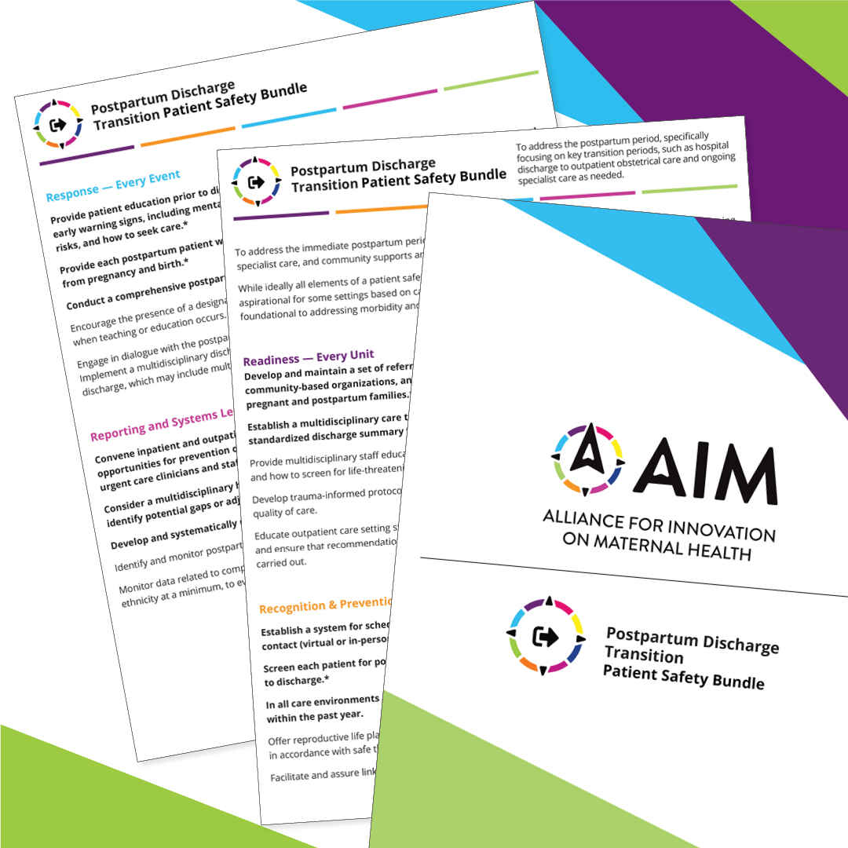
Patient Safety Bundles
“A bundle is a structured way of improving the processes of care and patient outcomes:
Small
Straightforward
Evidence-based
The power of a bundle comes from the body of science behind it and the method of execution: with complete consistency.
Performed uniformly
A bundle ties the changes together into a package of interventions that people know must be followed for every patient, every single time.”
—Institute for Healthcare Improvement
Notes:
AIM work is implemented via safety bundles. Bundles are a way of grouping known best practices in care for specific clinical conditions to be implemented consistently for every patient, every time and are a tool. Bundles are not a fully holistic solution, but rather a framework and tool to impact the care we provide. They are only a piece of paper if not implemented effectively by multidisciplinary teams. But with PSB implementation, the care of all people being offered can improve.

Slide 8
Why Work Together?
Obstetric Hemorrhage PSB- percentage of participating facilities with a hemorrhage cart increased from 28% in 2016 to 95% in 2020
Obstetric Hemorrhage PSB-percentage of providers who received education on obstetric hemorrhage and their unit standard protocols increased from 45% to 84% among participating facilities between October 2019 and December 2021.
Substance Use Disorder PSB- percentage of participating facilities with a universal screening protocol for substance use disorder increased from 33% to 86% between December 2020 and December 2021.
MS
NY
OR
Notes:
So what is happens when folks do work together? Well on the screen you can see 3 state-based examples of the AIM impact, brought about by PQCs. In Mississippi, when the OB Hemorrhage bundle was implemented, the baseline number of facilities with hemorrhage carts increased from 28 to 95%. In NY, with implementation of the Care for the pregnant and postpartum people with substance use disorder bundle, the number of participating facilities with a universal verbal screening protocol in place for SUD increased from 33 to 86%. If you see the dates, you’ll notice that this was done during COVID-19 pandemic, really notable outcome. Finally, in Oregon the percentage of providers who received education on hemorrhage and their unit standard protocol increased from 45 to 84% with Hemorrhage bundle implementation, and again this was during COVID-19. So how do PQCs determine what bundles and projects to focus on? I will hand off to Dr. Eppes to talk more about the work that maternal mortality review committees do and how they can promote birth equity as part of the bigger puzzle.

Slide 9
AIM, MMRCs, and PQCs
Alliance for Innovation on Maternal Health moves established guidelines into practice with a standard approach to improve safety in care
Perinatal Quality Collaboratives mobilize state or multi-state networks to implement clinical quality improvement efforts and improve care for perinatal patients and their babies
AIM
PQCs
Maternal Mortality Review Committees conduct detailed reviews for complete and comprehensive data on maternal deaths to prioritize statewide prevention efforts
MMRCs
Created from a Centers for Disease Control, Division of Reproductive Health source

Slide 10
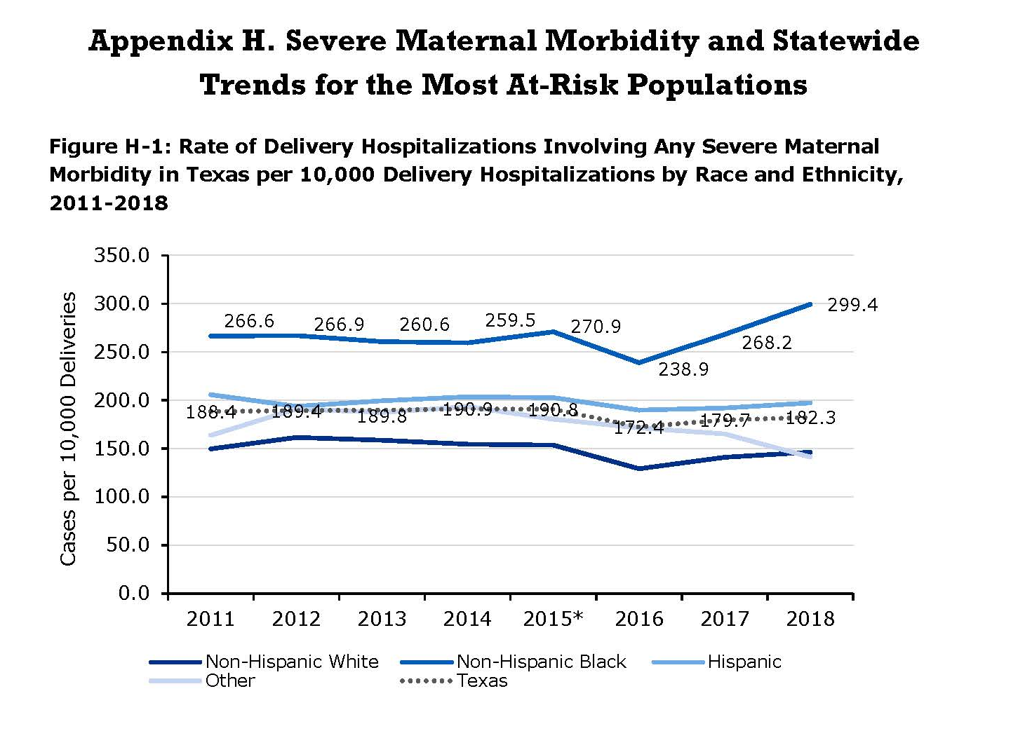
Texas MMMRC Findings
Notes:
Among reviewed 2013 cases identified as pregnancy-related, 31 percent of deaths were among Non-Hispanic Black women, 41 percent among Non-Hispanic White women, 26 percent among Hispanic women, and 2 percent among women of other races and ethnicities. In contrast, 11 percent of live births in 2013 were among Non-Hispanic Black women, 34 percent among Non-Hispanic White women, 48 percent among Hispanic women, and 6 percent among women of other races and ethnicities.
Factors that contribute to a pregnancy-related death may impact a woman over her life course. The MMMRC identified 367 factors that contributed to the 54 pregnancy- related cases reviewed from the 2013 cohort, an average of 6.8 contributing factors per case. Contributing factors are categorized within domains that indicate the levels at which actions should be targeted for prevention.8 Identified contributing factors of pregnancy-related death were distributed among the patient and family (34 percent of cases), provider (24 percent of cases), facility (17 percent of cases), systems of care (18 percent of cases), and community (7 percent cases) domains.

Slide 11
Texas MMMRC Findings
Disparities persist in maternal mortality. Non-Hispanic Black women are disproportionately impacted.
1
Severe maternal morbidity (SMM) disproportionately impacts Non-Hispanic Black and Hispanic women. Rates of delivery hospitalizations involving any SMM at delivery vary by county.
2
Rates of delivery hospitalizations involving hypertensive disorder were highest among Non-Hispanic Black mothers and varied by county.
3
Notes:
Among reviewed 2013 cases identified as pregnancy-related, 31 percent of deaths were among Non-Hispanic Black women, 41 percent among Non-Hispanic White women, 26 percent among Hispanic women, and 2 percent among women of other races and ethnicities. In contrast, 11 percent of live births in 2013 were among Non-Hispanic Black women, 34 percent among Non-Hispanic White women, 48 percent among Hispanic women, and 6 percent among women of other races and ethnicities.
DSHS will determine the final size and racial-ethnic distribution of 2013 pregnancy- related deaths after the MMMRC complete their review of the 2013 case cohort.

Slide 12
Texas MMMRC Recommendations
Recommendation #2 — Engage Black communities and apply health equity principles in the development of maternal and women’s health programs.
Recommendation #5 — Implement statewide maternal health and safety initiatives to reduce maternal mortality and morbidity.
Recommendation #6 — Foster supportive community environments and leverage programs and services that help women of childbearing age achieve their full health potential.

Slide 13
Primary Drivers
Secondary Drivers
In all hospital care settings (L&D, Triage/OB ED, Main ED, Antepartum, PP, Critical Care, outpatient, etc.)
Standards for early warning signs, diagnostic criteria, monitoring & treatment of severe HTN, preeclampsia with severe features and/or eclampsia, to include applicable order sets & algorithms
Unit education on severe HTN + protocols; culture of team work including in-situ sim, & unit-based drills + debrief
Process for timely triage and evaluation of pregnant/PP women
Rapid availability & access to stocked HTN/eclampsia medications + admin guide
System plan for escalation, obtaining appropriate consultation, & maternal transport as indicated
System plan, education and training on communication about and accurate documentation of self-identified race, ethnicity, and primary or preferred language
Education on disparities, bias, patient-centered care & shared decision making
Engage diverse patient, family, and community advocates who can represent important community partnerships on quality & safety leadership teams.
ENSURE STAFF, STRUCTURES, AND PROTOCOLS ARE PRIMED to provide recommended care for women with severe maternal HTN
STANDARDIZE READINESS
STANDARDIZE RECOGNITION AND PREVENTION
IDENTIFY pregnant and postpartum women in all departments
ASSESS women for severe maternal HTN
For every pregnant and PP patient:
Standard protocol for accurate measurement & assessment of BP, urine protein
Standard response to early warning signs: listen to patient | investigate symptoms| assess labs
Facility-wide standardized patient and family education on S/S of HTN and preeclampsia/ anticipatory guidance for Urgent Maternal Warning Signs
Mechanism and process for patient family and staff reporting experiences of inequitable or disrespectful care
TREAT in 30 to 60 minutes of first severely elevated reading every pregnant/postpartum woman with acute onset of severe HTN
For every case of severe HTN/preeclampsia:
Facility-wide standard protocols with checklists and escalation policies for management, treatment, and coordination of follow up/transitions of care for: severe HTN; Eclampsia, seizure prophylaxis, and magnesium over-dosage; and PP presentation of severe HTN/preeclampsia
Use of shared decision-making model
Patient access to and communication of her health history and medical record
Program/plan for patient, family, and staff support for HTN-associated SMM (ICU admission and other sequalae)
Patient and family education and anticipatory guidance on long-term risks and recommended follow up
STANDARDIZE RESPONSE
FOSTER A CULTURE OF
SAFETY, EQUITY, and IMPROVEMENT, for care of pregnant and postpartum women with HTN
Every unit:
Culture of communication including briefs, huddles & post-event debriefs for patients at risk for/impacted by severe HTN to ID opportunities and successes
Culture of equity, including systems for reporting, response, and learning
Multi-disciplinary review for severe HTN/preeclampsia cases associated with SMM (ICU admission and other severe outcomes); consider demographics & social determinants of health in case review, including racism at the interpersonal and system levels
Monitor, evaluate, disseminate/communicate using dashboard of structure, process, & outcome metrics that are stratified by race, ethnicity, language and other factors
Quality improvement efforts from review of cases & data; Apply an equity framework (e.g. Targeted Universalism)
HARDWIRE PROCESSES WITH
HARDWIRE PROCESSES THROUGH REPORTING & SYSTEMS LEARNING
Notes:
A proxy SMM measure is ICU admission, which is considered the most reliable indicator of SMM. This was the lead indicator used by the AHA Obstetrical Harm Initiative: http://patientcarelink.org/wp-content/uploads/2016/06/HRETHEN_ChangePackage_OBHarm.pdf.
However, this is but this will miss a substantial portion of HTN-associated SMM.
See:
https://www.hcup-us.ahrq.gov/reports/statbriefs/sb243-Severe-Maternal-Morbidity-Delivery-Trends-Disparities.jsp
https://www.hcup-us.ahrq.gov/reports/statbriefs/sb222-Preeclampsia-Eclampsia-Delivery-Trends.pdf

Slide 14
In all hospital care settings (L&D, Triage/OB ED, Main ED, Antepartum, PP, Critical Care, outpatient, etc.)
Standards for early warning signs, diagnostic criteria, monitoring & treatment of severe HTN, preeclampsia with severe features and/or eclampsia, to include applicable order sets & algorithms
Unit education on severe HTN + protocols; culture of team work including in-situ sim, & unit-based drills + debrief
Process for timely triage and evaluation of pregnant/PP women
Rapid availability & access to stocked HTN/eclampsia medications + admin guide
System plan for escalation, obtaining appropriate consultation, & maternal transport as indicated
System plan, education and training on communication about and accurate documentation of self-identified race, ethnicity, and primary or preferred language
Education on disparities, bias, patient-centered care & shared decision making
Engage diverse patient, family, and community advocates who can represent important community partnerships on quality & safety leadership teams.

Slide 15
AIM, MMRCs, and PQCs
Alliance for Innovation on Maternal Health moves established guidelines into practice with a standard approach to improve safety in care
Perinatal Quality Collaboratives mobilize state or multi-state networks to implement clinical quality improvement efforts and improve care for perinatal patients and their babies
AIM
PQCs
Maternal Mortality Review Committees conduct detailed reviews for complete and comprehensive data on maternal deaths to prioritize statewide prevention efforts
MMRCs
Created from a Centers for Disease Control, Division of Reproductive Health source
Notes:
PQCs are state or multistate networks that improve measurable outcomes for maternal and infant health by advancing evidence-informed clinical practices and processes using quality improvement (QI) strategies.
They address gaps by working with clinical teams, public health leaders, and other stakeholders, including patients and families, to implement statewide initiatives that spread best clinical practices, reduce variation in practice, and promote health equity

Slide 16
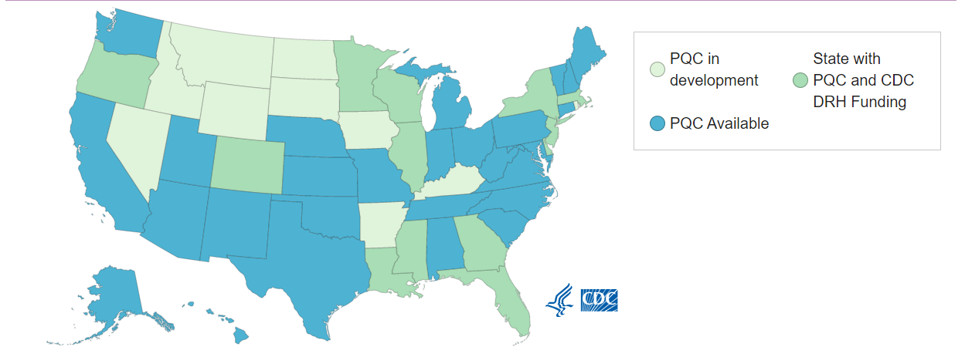
Status of PQCs in the US
Notes:
There are PQCs in place or in development in all 50 states, which form an amazing community of sharing and support through a national network of PQCs funded by the CDC. All PQC are unique in their structure and approach but have much in common.
.

Slide 17






Initiative Selection and Buy-in: ILPQC’s Approach
Survey ILPQC hospital teams pre-conference
State PQC leaders share overviews of initiatives at conference
Discuss and vote on initiatives at conference break out sessions
Develop buy-in with advisory workgroup, regionalized perinatal system
Engage key stakeholder buy-in
Notes:
Carey described how MMRCs generate recommendations that are used to inform PQC initiatives in the previous slides and how they used the recommendations in Texas to select an initiative.
MMRC recommendations are a part of a PQCs approach to inform initiative selection and facilitate buy-in to work on the initiative
For example ILPQC’s approach is to look at the MMRC recommendations and take different ideas for initiatives to our collaborative
Develop buy in of our Advisory Workgroups and Department of Public Health Regionalized Perinatal System and engaging key stakeholders across state health agencies and leadership team members
Survey ILPQC hospital teams before our annual conferences on their interests and priorities
Invite other state PQC leaders to share overviews of their initiatives and demonstrated improvement at our annual conference
Discuss options and voting on initiatives in our conference breakout sessions

Slide 18
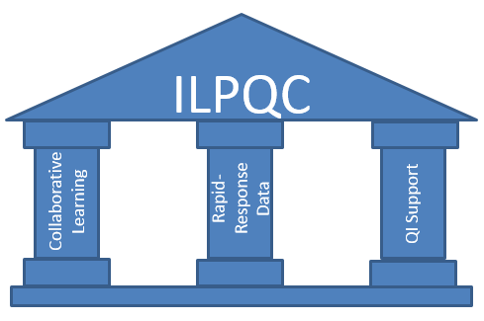
Collaborative Improvement Science –
ILPQC’s Approach
SMART
Structure, Process, Outcome, Balancing
QI Resources
Leadership, Advisors, Stakeholders, Patients/Families
Langley GL MR, Nolan TW, Norman CL, Provost LP,. 2009
Notes:
State-based perinatal quality collaboratives (PQCs) have shown that the application of collaborative improvement science methods can optimize perinatal health outcomes. ⁵
For example, ILPQC Uses Quality improvement science to Build Hospital Capacity to Drive Systems & Culture Change
When developing initiatives we utilize the breakthrough series model for improvement creating specific, measurable, achievable, realistic, and time-specific or SMART aims
Create a rapid response data system that allowed teams to track and compare their data to track progress on smart aims using structure, process, outcome, and balancing measures
To help hospital teams identify strategies to achieve initiative aims, we provide opportunities for collaborative learning across hospitals through in person events, and monthly web-based meetings
And to facilitate identification and execution of tests of changes to achieve aims, we [rovide quality improvement / QI support to hospital teams through quality improvement resources such as a toolkit, regional network meetings and QI coaching calls.

Slide 19


Incorporation of AIM into the work of the PQC – ILPQC’s approach
Provides a national community for idea sharing and implementation support
Patient Safety Bundles provide a framework for developing a state-wide quality improvement initiative and help to develop buy-in
Measures provide a starting point for developing initiative structure, process, and outcome measures and
Data portal provides platform to shar data for national benchmarking comparisons
ILPQC Hospitals
Notes:
PQCs incorporate AIM Patient Safety bundles into their work to increase improvement capacity, for ILPQC, AIM provides
National community for idea sharing and implementation support
Patient Safety Bundles provide a framework for developing a state-wide quality improvement initiative and help to develop buy-in
Measures provide a starting point for developing initiative structure, process, and outcome measures and
And the data portal provides platform to shar data for national benchmarking comparisons

Slide 20
Equity and Engagement in PQC and AIM Work

Slide 21
Equity in the AIM Patient Safety Bundles
Readiness
Recognition and Prevention
Response
Reporting and Systems Learning
Respectful Care
Notes:
PSBs are build on a 5 “R” framework. As you can see here, that includes Readiness, Recognition and Prevention, Response, Reporting and Systems Learning, and Respectful Care. Each heading contains elements to be implemented with RC specifically calling out actions to support respectful, equitable, and supportive care. But equity considerations are also woven into the other 4 Rs, as equity and antiracism are foundational to high quality care. So for example, in reporting and systems learning, it might call for disaggregation of reported data by race and ethnicity. By collecting data in this way, we are able to figure out if the care we are providing is truly equitably being applied. With more on applying care equitably, here is Dr. Eppes.

Slide 22
Patient
Centered
Timely
Effective
Efficient
Safe
care is respectful of and responsive to preferences, needs, and values. patient values guide all clinical decisions.
reducing waits and harmful delays for both those who receive and give care
Equitable
Provide services based on scientific knowledge to all who could benefit & over overuse
avoiding waste, of equipment, supplies, ideas and energy
providing care that does not vary in quality because of personal characteristics such as gender, ethnicity, geographic location, and socio-economic status..
avoiding injuries to patients from the care that is intended to help them
Crossing the Quality Chiasm.
Pillars of Quality
Institute of Medicine 2001. Crossing the Quality Chasm: A New Health System for the 21st Century. Washington, DC: The National Academies Press.

Slide 23
How Texas Has Prioritized Equity
Our MMMRC includes statewide administrative data and bias assessment in case review
Part of our core strategic plan for our PQC
All QI projects pass thru our Race Equity Workgroup for assessment and planning
  Equity impact assessment at the onset
  Plan to incorporate those with lived experiences
  Dissaggregation of data
  Develop QI interventions that specifically that emphasize addressing needs of marginalized populations and the root causes of disparities
Notes:
How PQCs address equity across initiatives / work (IL, TX, AIM – other states) – actionable strategies, toolbox (15 min)
Looking at data by race and ethnicity - How to Collect, Stratify, and Display Data
Health Equity as Foundational to Perinatal Quality Improvement: How to be Intentional about Your Project
M&M/MMRC reviews - How to Incorporate Race/Racism/Bias/Social Determinants of Health into Severe Maternal Morbidity and Mortality Case Reviews and Debriefs
Social determinants of health screening and linkage to care
Patient / family / community engage - How to Incorporate Diverse Patients and Community-Based Organizations into Hospital Quality Improvement Committees
Respectful care and patient reported experience measures (one slide weighing what we know / don’t)

Slide 24
Texas Collaborative for Healthy Moms and Babies Mission Statement
TCHMB Vision
All Texas mothers and babies will have the best possible health outcomes
TCHMB Mission
To Advance the health care quality, equity and patient safety for all Texas mothers and babies through the collaboration of all health and community stakeholders as informed by the voices of the patients we serve
TCHMB Goals
Reduce Preterm Birth
Reduce morbidity and mortality of all mothers and babies
Eliminate health outcome disparities and inequities for mothers and babies, especially associated with race and ethnicity
Improve the health outcomes of mothers and babies using the life course approach
Strengthen the involvement of partners/families with maternal and child health
Improve the health environment for mothers and babies

Slide 25
High-level strategy: Implement high valued quality improvement projects that address health priorities, promote equity and eliminate disparities
Each project has a strategy to address disparities and promote equity goals to include:
  Identify equity goals at the outset
  Engage or seek input from individuals or groups in the project who represent populations impacted by disparities
  Conduct interventions that preferentially address barriers of groups impacted by disparities
  Collect and assess outcome and process measures by race/ethnicity and language (as appropriate to the project and site)
Notes:
Detail actionable strategies and tactics
Performance measures:
Projects report disaggregated data based on race, ethnicity, other areas with disparate outcomes
Benchmark:
100% of projects integrate health equity considerations (essential to ensure health equity considerations are being addressed.)
100% of proposed projects incorporate a baseline assessment of health disparities/inequities (collection and use of REaL data)

Slide 26
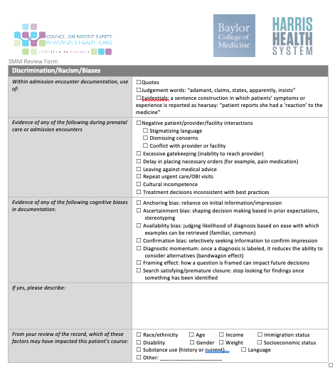
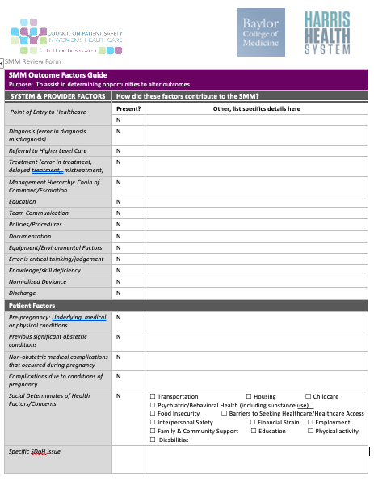
Inclusion of bias in QI efforts
Inclusion of bias and SDoH in case review
Incorporation of patient representation in planning and learning activities
Simulation for bias

Slide 27

Disaggregation of data
Describe the use of REaL (Race, Ethnicity, and Language) data in quality improvement to support achievement of equitable health care
Describe recommended processes/steps for collection of accurate and complete REaL data
Notes:
2 trainings in our annual summit
Inclusion of those with lived experiences within your care team
Implicit bias ”training”

Slide 28
ILPQC Birth Equity Aims and Drivers
Over 85% of IL birthing hospitals are working on this foundational initiative that will build on existing hospital efforts and lay the groundwork for ongoing equity work to address maternal disparities and promote birth equity
AIMS: By December 2023,
more than 75% of Illinois birthing hospitals will be participating in the Birth Equity Initiative and
more than 75% of participating hospitals will have the key strategies in place.
Promote patient- centered approach to engage patients and communities
Develop respectful care and bias education for providers, nurses, and staff
Addressing Social Determinants of Health
Review race/ethnicity medical record and quality data
Notes:
Over 85% of IL birthing hospitals are working on this foundational initiative that will build on existing hospital efforts and lay the groundwork for ongoing equity work to address maternal disparities and promote birth equity
Our aims for the initiative are to have
more than 75% of Illinois birthing hospitals will be participating in the Birth Equity Initiative and
more than 75% of participating hospitals will have the key strategies in place.
Our key strategies are organized within 4 drivers of change to improve birth equity, including addressing social determinants of health
Reviewing race/ethnicity medical record and quality data to monitor data for racial disparities in process and outcome measures
Promoting patient-centered approach to engage patients and communities
And develop respectful care and bias education plan for providers, nurses, and staff

Slide 29
ILPQC – Birth Equity Key QI Strategies
Optimize race/ethnicity data collection & review key maternal quality data by race, ethnicity & Medicaid status
Engage patients and community members for input on quality improvement efforts
Universal social determinants of health screening tool (prenatal/L&D) with system for linkage to appropriate resources
Share respectful care practices on L&D and survey patients before discharge on their care experience (using the PREM) for feedback
Standardize postpartum safety education and schedule early postpartum follow up prior to hospital discharge
Implicit Bias / Respectful Care training for providers, nurses and other staff
Notes:
The key quality improvement strategies we are working on with hospital teams
Optimize race/ethnicity data collection and review key maternal quality data by race, ethnicity and Medicaid status
Universal social determinants of health screening tool (prenatal/L&D) with system for linkage to appropriate resources
Share respectful care practices on L&D and survey patients before discharge on their care experience (using the PREM tool) for feedback
Engage patients and community members for input on quality improvement efforts
Standardize postpartum safety education and schedule early postpartum follow up prior to hospital discharge
Implicit Bias / Respectful Care training for providers, nurses and other staff

Slide 30

ILPQC - Expanded resources for engaging patients, families and communities
  Serve on patient advisory councils or hospital QI teams
Patient engagement pilot with consultant LaToshia Rouse
Regional community engagement meetings with consultant Everthrive and Tamela Milan-Alexander
I PROMOTE IL (HRSA) Maternal Health Task Force engagement
Patient focus groups and feedback on initiative resources
Infant and Maternal Mortality Among African Americans Task Force engagement
Patient and family stories shared at all-collaborative meetings

Slide 31
How to Get Involved

Slide 32




Framework for engaging hospital teams and implementing QI initiatives across Illinois
Engage
Motivate
Support
Notes:
There are several ways for clinicians to get involved with PQCs, and ILPQC We use a framework for engaging hospital teams and implementing QI initiatives across where we
Engage hospitals to create an environment of improvement;
Motivate hospital teams to facilitate change at their hospital; and
Support hospital teams through with collaborative learning opportunities, rapid-response data, and QI support-to achieve initiative goals and improve outcomes for birthing people and their newborns
As members of the hospital quality improvement , we directly engage clinicians at every level of the collaborative and
Provide supports to hospital quality improvement teams to engage providers and nurses at the clinical/ hospital level

Slide 33
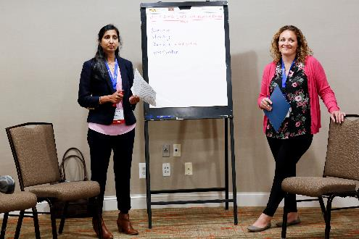



Promoting clinician engagement in the work of the collaborative
ILPQC Clinician Engagement
OB Advisory Group
Neonatal Advisory Group
QI Initiative Clinical Leads
Grand Rounds Speakers Bureau
Face-to-Face Breakout Session Facilitators
Sub-Workgroups & Expert Panels
Notes:
We engage providers and nurses in the work of the collaborative through
OB advisory workgroups with members across the state who provide input across initiatives over the course of the entire initiative
Quality Improvement Initiative Clinical Leads
Grand Rounds Speakers Bureau who deliver grand rounds at requesting hospitals across the state
Face to Face Meeting Breakout Session Discussion Facilitators who identify barriers and strategies to implementing the quality improvement initiatives
Opportunities to serve on Workgroup subgroups and expert panels related to specific aspects of the initiatives

Slide 34

Resources for hospital QI teams to engage clinicians at the clinical/hospital level
Provide context and evidence for why we doing this work
Define strategies and provide resources for systems change
Support culture change with resources for clinician education
Promote hospital quality improvement data utilization and sharing with clinicians
  Develop tools to track compliance and provide feedback
Notes:
In addition, ILPQC provides resources for hospital QI teams to engage clinicians at the clinical/hospital level
Provide context and evidence to build the case for why we doing this work to help with buy-in
Define strategies and provide resources for systems change that assist clinical teams in hospitals doing the right thing every time (e.g. protocols, checklists, order sets, debriefs)
Support culture change with resources for provider and nursing staff education (e.g. grand rounds with speakers, e-modules, simulations, drills)
Promote hospital quality improvement data utilization, including a data system with reports on hospitals monthly data progress with comparison to other participating to share with clinicians
Develop tools to track compliance when optimal care is not achieved and provide feedback for improvement

Slide 35

Benefits of Participation for Clinicians
Tools and resources to support evidenced-based practices
Networking and speaking opportunities
Leadership opportunities
American Board of Obstetrics and Gynecology (ABOG) Maintenance of Certification Part IV credits
Notes:
Benefits of Participation for Clinicians
Tools and resources to support implementation of evidenced-based practices
Networking and speaking opportunities at twice-annual all collaborative meetings and grand rounds speakers’ bureau
Leadership opportunities on advisory workgroups and initiative clinical lead teams
American Board of Obstetrics and Gynecology (ABOG) and American Board of Pediatrics (ABP) Maintenance of Certification Part IV credits

Slide 36

Patients with Lived Experience in AIM
Seek to integrate those with lived experience from the start of any project
AIM staff provide support to participants in an ongoing way
Leveraging community-based organizations in identifying patient subject matter experts
Ensure equal subject matter expert status for all team members
Notes:
A word about best-practices we use when we engage with patients with lived experience in AIM- we start all projects with the full integrations of patents from the start, not at the end to “bless” a project. We work to make sure that patients who join our work, specifically for the long process of bundle development are generally more than 1, to provide mutually support, and we check in with them early and often. We want to make sure we are providing opportunities for them to take time and space as well if needed, if they find themselves struggling with content or topics. We seek out patients in a lot of ways, but via community based organizations allows them to have full support from that org and resources to share as needed. And finally, we make sure that PLECs are treated as the SME they are, not just there to tell their story, but to leverage their lived experiences to impact and shape the work we do.

Slide 37
Data and Systems Based Learning (MMMRCs)
Perinatal Quality Collaboratives
Equitable and
Optimal
Maternal Health
Outcomes
Communities
Impacted
Evidenced Based Interventions
(AIM)
Patients with Lived experience

Slide 38
Thank you!

