Slide 2
Root Causes of Pregnancy-Related Racial and Ethnic Health Disparities
Lauren Arrington, DNP, CNM
Assistant Professor, Georgetown University, School of Nursing and Health Studies
Nurse-Midwife, University of Maryland St. Joseph Medical Center
Christina Davidson, MD
Associate Professor, Division of Maternal Fetal Medicine, Baylor College of Medicine
Vice Chair of Quality, Patient Safety & Equity, Department of Obstetrics & Gynecology, Baylor College of Medicine
Chair, Society for Maternal-Fetal Medicine Patient Safety and Quality Committee

Slide 3
What is a Root Cause(s) Analysis?
A structured method used to analyze serious adverse events
A process for identifying the basic or causal factors that underlie variation in performance
Focuses primarily on systems and processes, not individual performance
There may be multiple root causes of a problem; different people who see different parts of the system may answer the questions differently
Notes:
RCA: used for Sentinel events as defined by Joint Commission, All serious safety events at TCH

Slide 4
Notes:
5 whys: one way to identify root cause of a problem is to ask “Why?” 5 times
When a problem presents itself, ask “Why did this happen?”
Don’t stop at the answer to this first question. Ask “Why?” again and again until you reach the root cause.

Slide 5
Health Disparities vs. Inequities
Health disparities
Difference in health outcomes between groups within a population
Related to social or demographic factors
Health inequities
Differences in health outcomes that are systematic, avoidable, and unjust
Created when barriers prevent individuals and communities from accessing conditions that allow them to reach their full potential
IHI Improving Health Equity: Make Health Equity a Strategic Priority; SMFM Special Report. Am J Obstet Gynecol. 2018 Feb;218(2):B9-B17; Greenwood B, et al. Proc Natl Acad Sci U S A. 2020 Sep 1;117(35):21194-21200; Pregnancy Mortality Surveillance System, 2011-2015. MMWR 2019;68:423-9; Howell, E et al. Clin Obstet Gynecol. 2018 Jun;61(2):387-399
Notes:
Health Disparities: the difference in health outcomes between groups within a population; differences between the health of one population and another in measures of who gets disease, who dies from disease, and other adverse health conditions that exist among specific population groups in the US. Healthy People 2030 defines a health disparity as “a particular type of health difference that is closely linked with social, economic, and/or environmental disadvantage. Health disparities adversely affect groups of people who have systematically experienced greater obstacles to health based on their racial or ethnic group; religion; socioeconomic status; gender; age; mental health; cognitive, sensory, or physical disability; sexual orientation or gender identity; geographic location; or other characteristics historically linked to discrimination or exclusion.” Healthy People 2030 Questions & Answers | health.gov
Non-Hispanic black women are 3-4 times more likely to die from pregnancy related causes than Non-Hispanic white women. This disparity in maternal death currently represents the largest disparity among all the conventional population perinatal health measures. Non-Hispanic black women have had the fastest rate of increase in maternal deaths between 2007 and 2014, and have maternal death rates up to 12 times higher in some cities than non-Hispanic white women.
While the terms “health disparity” and “health inequity” may seem interchangeable, they are different. Health disparity denotes differences, whether unjust or not. Health inequity, on the other hand, denotes differences in health outcomes that are systematic, avoidable, and unjust. Inequities are created when barriers prevent individuals and communities from accessing conditions that allow them to reach their full potential. Examples of such barriers include instable housing, lack of access to clean water, and lack of neighborhood safety. Inequities differ from health disparities, which are differences in health status between people that are related to social or demographic factors such as race, gender, age, income or geographic region. Health disparities are one way we can measure our progress toward achieving health equity. According to the CDC, health inequities are differences or disparities in health outcomes that are systematic, avoidable, and unjust. They are the result of social, economic, and environmental conditions.
Health Disparity = difference in a health outcome between populations
Health Inequity = difference in a health outcome by a social construct (such as race) that are avoidable, unfair, unjust, and rooted in social and structural inequities.
(Understanding the difference between health disparity and health inequity (columbia.edu)).
Black women have higher case-fatality rates from a range of conditions though the leading causes of maternal death for black and white women are similar. For example, Black women experience higher mortality from cardiomyopathy, hypertensive disorders of pregnancy, and hemorrhage while Hispanic women have an increased risk of death due to hypertensive disorders.
Health care disparity: Defined by the Institute of Medicine as “racial or ethnic differences in the quality of health care that are not due to access-related factors or clinical needs, preferences, and appropriateness of intervention.”
Ref = IHI Improving Health Equity: Make Health Equity a Strategic Priority
Health Equity: The opportunity for everyone to attain his or her full health potential. No one is disadvantaged from achieving this potential because of his or her social position (e.g., class, socioeconomic status) or socially assigned circumstance (e.g., race, gender, ethnicity, religion, sexual orientation, geography). Health equity means that everyone has a fair and just opportunity to be as healthy as possible. This requires removing obstacles to health such as poverty, discrimination, and their consequences, including powerlessness and lack of access to good jobs with fair pay, quality education and housing, safe environments, and health care. For the purposes of measurement, health equity means reducing and ultimately eliminating disparities in health and its determinants that adversely affect excluded or marginalized groups. health disparities—worse health in excluded or marginalized groups—are how we measure progress toward health equity.(what is health equity_robert wood johnson foundation.pdf)
https://www.acog.org/clinical-information/policy-and-position-statements/position-statements/2020/addressing-health-equity-during-the-covid-19-pandemic

Slide 6
Notes:
https://www.mdedge.com/obgyn/article/221705/obstetrics/american-maternal-mortality-crisis-role-racism-and-bias

Slide 7
Race vs. Racism “Race Is Not a Risk Factor, Racism Is.” Joia Crear-Perry, MD Founder and President of National Birth Equity Collaborative
Race: Social, NOT biologic, construct for grouping people, based on skin color and other apparent physical differences
Racism: system of advantage based on race
Internalized
Interpersonal
Institutional/Structural/Systemic
ACOG joint statement addressing racism: “Recognizing that race is a social construct, not biologically based, is important to understanding that racism, not race, impacts health care, health, and health outcomes.”
ACOG Joint Statement: Collective Action Addressing Racism. Aug 2020
IHI Liberation in the Exam Room: Racial Justice and Equity in Healthcare
Notes:
Racism: A system of advantage based on race
Internalized Racism: The set of private beliefs, prejudices, and ideas that individuals have about the superiority of whites and the inferiority of people of color. Among people of color, it manifests as internalized racial oppression. Among whites, it manifests as internalized racial superiority.
Interpersonal Racism: The expression of racism between individuals. These are interactions occurring between individuals that often take place in the form of harassing, racial slurs, or telling of racial jokes.
Institutional Racism: Discriminatory treatment, unfair policies and practices, and inequitable opportunities and impacts within organizations and institutions, based on race.
Structural Racism: Racial bias across institutions and society over time. It’s the cumulative and compounded effects of an array of factors such as public policies, institutional practices, cultural representations, and other norms that work in various, often reinforcing, ways to perpetuate racial inequity.
Systemic racism refers to the policies and practices rooted within macrolevel systems, institutions, and processes that interact with one another and reinforce inequities among racial/ethnic groups. Systemic racism is separate from interpersonal or internal racism and manifests in two ways: structural and institutional racism. (NQF environmental scan)

Slide 8
Allostatic Load
Allostatic load/weathering: cumulative physiological effects of stress over life course
Black women exposed to discrimination during pregnancy → adverse outcomes
Intersectionality: Black women have highest documented allostatic load scores
Annual Review of Sociology. July 2018. Vol. 44:319-340
Riggan KA, et al. J Racial Ethn Health Disparities. 2021 Feb;8(1):69-79.
Notes:
This is a visual description of the biosocial links between interpersonal discrimination and health. Interpersonal discrimination is identiﬁed by the brain as a stressor requiring immediate physiologic response, and also, overtime, it becomes a learned process that creates anticipation and vigilance towards possible future exposures. Sympathetic nervous system arousal occurs in response to discrimination stress exposure (2) and in concert with the upregulation of the hypothalamic-pituitary-adrenocortical axis (3), preparing the body for a “fight or flight” response. Together, these systems initiate stress activation and inﬂammatory responses. These changes are intended to protect the body from immediate harm, but when repeated or sustained inflict long-term damage. When stress exposure is chronic, these responses create ALLOSTATIC LOAD, or wear and tear on the body, and increase risks for a variety of adverse health outcomes throughout the life course. Consequently, discrimination is associated with morbidities including low birth weight, hypertension, abdominal obesity, and cardiovascular disease.
Women of color experience the impact of gender discrimination, sexual harassment, and sexism as well as race-related discrimination, suggesting that the accumulation of stress over the life course is intersectional. Out of all demographic groups, Black women have the highest documented allostatic load scores. The concept of “weathering,” first proposed by Geronimus in 1992, has guided exploration of how chronic stress before pregnancy may contribute to birth outcome disparities. This hypothesis proposes that the cumulative effects of racism, economic disadvantage, and associated stress over a Black woman’s lifetime erodes her health and puts her at higher risk for poor obstetric outcomes with increasing age.
Allostatic load may also be inherited; animal studies have demonstrated the transgenerational inheritance of epigenetic changes resulting from stress exposure. One study found that the length of gestation was progressively reduced in subsequent generations following maternal exposure to prenatal stress. Assuming these models translate to humans, women of color may have a unique vulnerability to pregnancy complications due to epigenetic predisposition of the racial discrimination experienced by prior generations, as well as a dysregulated stress response from chronic exposure to environmental stressors.
Black women are biologically 7.5 years older than White women of the same chronological age as measured by telomere length, with perceived stress and poverty accounting for 27% of this difference. A recent study measuring allostatic load biomarkers at 4 months prior to pregnancy found that a unit increase in allostatic load was associated with increased odds of preeclampsia (62%), preterm birth (44%), and low birthweight (39%).
Intersectionality: the interconnected nature of social categorizations such as race, class, and gender as they apply to a given individual or group, regarded as creating overlapping and interdependent systems of discrimination or disadvantage.
Stress-Related Biosocial Mechanisms of Discrimination and African American Health Inequities. Article in Annual Review of Sociology · July 2018 (https://www.annualreviews.org/doi/abs/10.1146/annurev-soc-060116-053403)
Acknowledging and Addressing Allostatic Load in Pregnancy Care. Journal of Racial and Ethnic Health Disparities

Slide 9
Racial/Ethnic Disparities in Maternal Morbidity and Mortality: Root Causes
Howell, E et al. Clin Obstet Gynecol. 2018 Jun;61(2):387-399
Notes:
This is a model demonstrating pathways to racial and ethnic disparities in severe maternal morbidity and mortality. The model highlights the importance of social determinants and includes patient factors, community and neighborhood factors, provider factors, and system factors.
The drivers of healthcare disparities exist at 3 main levels: patient, provider, and system.
Patient-level factors include the perceptions of the quality of care received, the quality of the relationship with the healthcare provider, and perceptions of health and illness from a sociocultural context. Patients’ perceptions related to their interpretations of symptoms of illness, the services they receive, and their sense of control over a proposed treatment regimen all represent personal and nonstructural barriers to healthcare.
Provider factors, which include the knowledge and attitudes of physicians, nurses, social workers, and other healthcare providers, may contribute to disparities in healthcare. Provider bias is also an important factor; There is a growing emphasis on the improvement of cultural competency among providers, that is, the establishment of effective interpersonal and working relationships with patients by recognizing the social and cultural influences that are important to them.
System-level factors that contribute to disparities include healthcare systems and services, financing, access to and use of healthcare, and the quality of care that is delivered. Several studies have demonstrated the presence of structural barriers to care that may reduce the likelihood of a patient making and keeping a healthcare appointment. These factors include lack of transportation, lack of or inadequate health insurance, scarcity of providers, and inconvenient health services locations. However, even after acquiring access to healthcare services, women of racial and ethnic minority groups continue to experience poor quality and differential care. (SMFM special report)

Slide 10
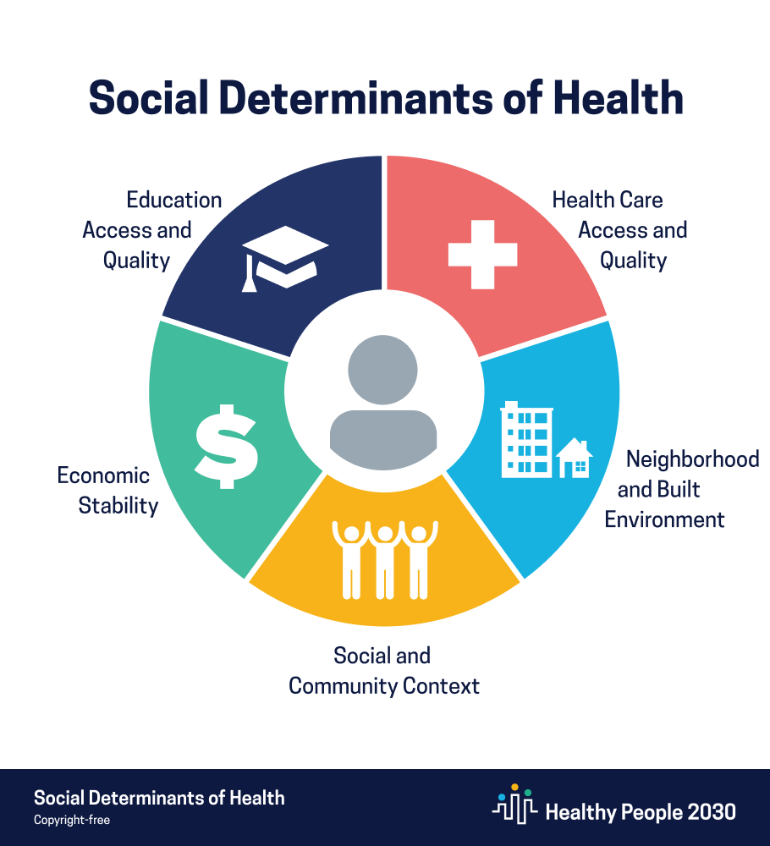
Patient Factors Conditions in the environment in which people are born, live, work, and age Shaped by historical, social, political, economic forces
ACOG CO #729, January 2018
https://health.gov/healthypeople/objectives-and-data/social-determinants-health
Notes:
SDoH are the conditions in the environment in which people are born, live, work, and age and are shaped by historical, social, political, and economic forces and help explain the relationship between environmental conditions and individual health. Structural racism has manifested in the social determinants of health through the historical impact of legalized racial residential housing and healthcare segregation, which led to underdeveloped neighborhoods with food deserts that still struggle economically today and hospitals and clinics that were once reserved for minority families that remained under-resourced.
Health care access and quality: includes health coverage, provider availability, provider linguistic and cultural competency, and the quality of Care
Neighborhood and built environment: includes quality of housing, access to transportation, availability of healthy foods, air and water quality, and neighborhood crime and violence
Social and community context: includes discrimination, conditions in the workplace, incarceration
Economic stability: includes poverty, employment, food security, housing stability
Education access and quality: includes educational attainment, language and literacy, early childhood education and development
The social determinants of health (SDH) exist “upstream” in that they occur and inter-relate with each other to ultimately influence characteristics that manifest further “downstream,” such as health behaviors, health conditions, and health outcomes. Only 20% of health outcomes can actually be attributed to clinical care. Upstream social determinants of health account for the other 80%, including social and economic factors (40%), physical environment (10%), and health behaviors (30%)

Slide 11
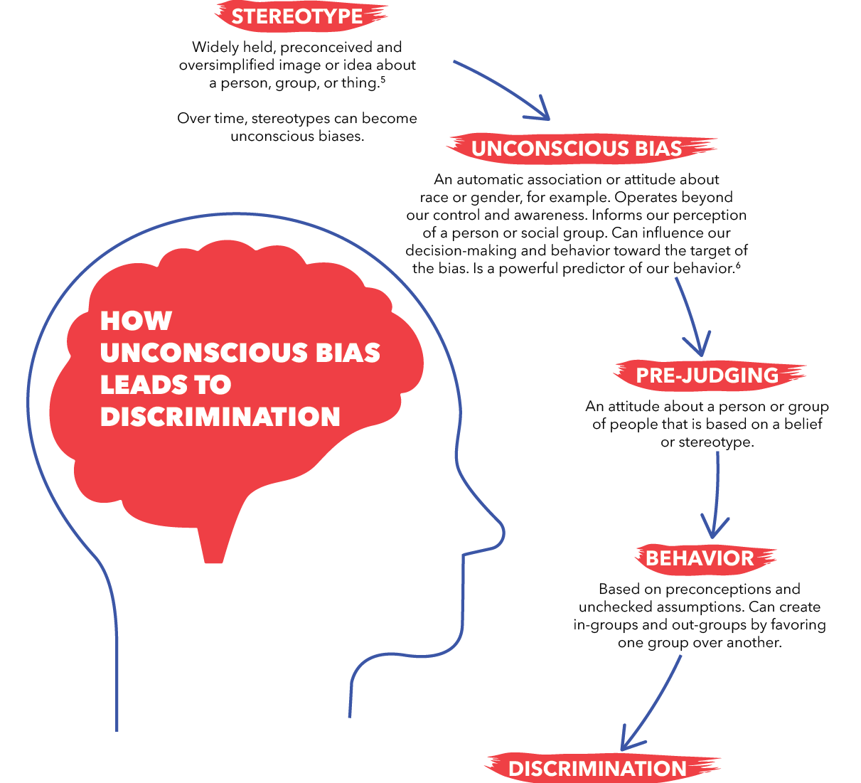
Provider Factors: Implicit/Unconscious Bias
Implicit/Unconscious Bias: attitudes and stereotypes that affect our understanding, actions, and decisions in an unconscious manner (unconscious discrimination)
Greatest effects in situations marked by ambiguity, stress, time constraints
Stereotyping and implicit bias of health care providers contributes to racial and ethnic disparities in health
Am J Obstet Gynecol. 2018 Feb;218(2):B2-B8.
Notes:
Implicit bias is a form of unconscious discrimination, in which attitudes and stereotypes affect our understanding, actions, and decisions in an unconscious manner. They represent a normal component of social cognitive processing. Implicit biases are activated involuntarily without an individual’s intentional control. They develop early in life from repeated exposure to and reinforcement of social stereotypes.
Implicit racial bias among physicians regarding treatment decisions has been shown to exist, even when physicians do not portray conscious (explicit) bias. The effects are greatest in situations marked by ambiguity, stress, and time constraints.
Research shows that the higher the level of unconscious bias in providers, the less likely they are to offer treatment to Black patients. Furthermore, literature on clinician bias demonstrates that clinicians’ perceptions and beliefs about the race and socioeconomic status of the patient influence the care that they deliver, resulting in disparities in patient outcomes. This may be particularly salient in labor management decisions, which are subject to the interpretation of individual clinicians. If clinicians believe, for example, that black women are more likely to end up delivering by cesarean, they may be quicker to recommend cesarean delivery, setting aside other labor management options or the woman’s goals for her birth experience.
Understanding the clinician-patient relationship and clinical decision-making style of clinicians (eg, shared decision-making) may augment our understanding of how birth preferences are enacted. (Ref=Birth: Prenatal attitudes toward vaginal delivery and actual delivery mode: Variation by race/ethnicity and socioeconomic status)
2015 SMFM survey: 83% of respondents agreed that disparities have an impact on their practice; only 29% believed that personal biases affect how they care for patients
Many medical students enter their training with racial biases that are unconsciously reinforced. Race is often learned as an independent risk factor for disease, rather than as a mediator of structural inequalities resulting from racist policies. Health disparities are presented without context, leading students to develop harmful stereotypes on the basis of the belief that some populations are more diseased than others. Students learn to associate race with disease conditions, such as sarcoidosis, cystic fibrosis, hypertension, and focal segmental glomerulonephritis, which upholds their implicit understandings of race as a biological trait.33,34 Professors might misleadingly equate genetic ancestry, which could be meaningful when traced to a narrowly circumscribed population of origin (eg, Biafada people), with race (eg, African ancestry).35,36 On the wards, students learn that race is relevant to treatment decisions and have inadequate power to question the racialised assumptions of their supervisors.37–40 In this way, race-based medicine is quickly propagated. (Ref=From race-based to race-conscious medicine)

Slide 12
System Factors: Delivery Hospital Quality & Access to Care
Variation in hospital quality → racial/ethnic disparities
Racial/ethnic minority women deliver in different and lower quality hospitals than White women
Hospitals that disproportionately care for Black deliveries have higher risk-adjusted SMM rates for both Black and White women
Racial/ethnic disparities documented both between and within hospitals
Compared to Whites, Hispanics 3X as likely to be uninsured; Blacks 2X
Howell E, et al. Obstet Gynecol 2020;135:285–93; Howell E, et al. Am J Obstet Gynecol. 2016 Aug;215(2):143-52; Howell, E et al. Clin Obstet Gynecol. 2018 Jun;61(2):387-399
Notes:
Studies have demonstrated that Black patients tend to receive care in hospitals with higher mortality rates and lower rates of effective evidence-based medical treatments compared with white patients. These studies suggest that place matters and there is growing attention to improving quality of care during delivery hospitalization to reduce disparities in maternal mortality and morbidity. It also important to note that racial and ethnic disparities have been documented both between hospitals and within hospitals and improvements in quality of care may address both of these causes of disparities. Hospitals that disproportionately care for black deliveries have been shown to have higher risk-adjusted severe maternal morbidity rates for both black and white women in those hospitals.
(Ref=Reducing Disparities in Severe Maternal Morbidity and Mortality Elizabeth A Howell)
Multiple studies have investigated the impact of site of care on obstetric outcome disparities. Recent data suggests that a sizeable portion of racial and ethnic disparities in severe maternal morbidity and mortality may be explained by variation in hospital quality.
Howell et al. examined maternal morbidity in New York City and found significantly higher rates of morbidity at hospitals with high rates of non-Hispanic black patients than primarily non-Hispanic white patients; they concluded that at least some of the difference was due to hospital performance, inasmuch as they inferred from their data that the same patients would have had better outcomes at primarily white-serving hospitals. most quality indicators had the best performance in Hispanic-serving hospitals, with black-serving hospitals having the poorest performance of all hospitals. Additionally, black individuals in primarily non-black-serving hospitals had significantly poorer outcomes than other races/ethnicities, while at primarily black-serving hospitals all races/ethnicities had similarly poor outcomes, which the authors suggested indicated that the primarily black-serving hospitals were of poorer quality in general.
Research has documented racial and ethnic disparities in severe maternal morbidity rates and that between-hospital differences—ie, black and Latina mothers receiving care at hospitals with worse outcomes—explain a sizable portion of these disparities. However, less attention has been paid to within-hospital disparities—whether black and Latina mothers have worse outcomes than white mothers who deliver in the same hospital. Medicaid covers nearly half of the deliveries in the United States; black and Latina pregnant women are more likely to be insured by Medicaid than are white pregnant women. In other areas of medicine, research has documented that patients insured by Medicaid tend to receive lower quality of care than patients insured by commercial insurance even within the same hospital. There are reasons to suspect that insurance type may contribute to racial and ethnic severe maternal morbidity disparities within the same hospital. Pregnant women insured by Medicaid may be cared for by a different set of physicians. Reimbursement levels for delivery are lower for Medicaid compared with commercially insured deliveries. The authors’ objective was to examine within-hospital racial and ethnic disparities in severe maternal morbidity rates and to determine whether they are associated with differences in types of medical insurance.
NYC population-based study examining within-hospital Black/White, Latina/White, and Medicaid/Commercially insured differences in SMM
Results:
SMM higher among Black and Latina women than white women (4.2% and 2.9% vs 1.5%, respectively, P,.001) and among women insured by Medicaid than commercially insured (2.8% vs 2.0%, P,.001)
No difference in risk of SMM within same hospital by insurance
Conclusion:
Within hospitals in NYC, Black and Latina women are at higher risk of SMM than white women and this is not associated with type of insurance
Multiple pathways contribute to disparities, including structural racism and bias in maternal health care
Future research efforts needed: causes of variation in care for pregnant Black and Latina women compared with white women within the same hospitals, such as patient–doctor communication, structural racism, bias, language issues, shared decision making, and differential use of obstetric-quality tools
METHODS: We conducted a population-based, crosssectional study using linked 2010–2014 New York City discharge and birth certificate data sets (N5591,455 deliveries) to examine within-hospital black–white, Latina–white, and Medicaid–commercially insured differences in severe maternal morbidity. We used logistic regression to produce risk-adjusted rates of severe maternal morbidity for patients with commercial and Medicaid insurance and for black, Latina, and white patients within each hospital. We compared these within hospital adjusted rates using paired t-tests and conditional logit models.
RESULTS: Severe maternal morbidity was higher among black and Latina women than white women (4.2% and 2.9% vs 1.5%, respectively, P,.001) and among women insured by Medicaid than those commercially insured (2.8% vs 2.0%, P,.001). Women insured by Medicaid compared with those with commercial insurance had similar risk for severe maternal morbidity within the same hospital (P5.54). In contrast, black women compared with white women had significantly higher risk for severe maternal morbidity within the same hospital (P,.001), as did Latina women (P,.001). Conditional logit analyses confirmed these findings, with black and Latina women compared with white women having higher risk for severe maternal morbidity (adjusted odds ratio [aOR] 1.52; 95% CI 1.46–1.62 and aOR 1.44; 95% CI 1.36–1.53, respectively) and women insured by Medicaid compared with those commercially insured having similar risk.
CONCLUSION: Within hospitals in New York City, black and Latina women are at higher risk of severe maternal morbidity than white women; this is not associated with differences in types of insurance.
The authors conclude that their results raise the hypothesis that effects of reduced reimbursement for Medicaid may operate at the hospital but not at the individual level. Disparities are a complex phenomenon and multiple pathways contribute to their occurrence. One pathway, documented by a growing body of research, is structural racism and bias in health care and in maternal health care specifically.

Slide 13
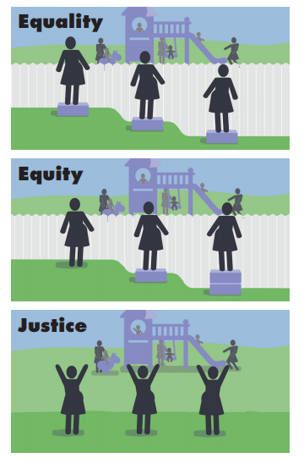
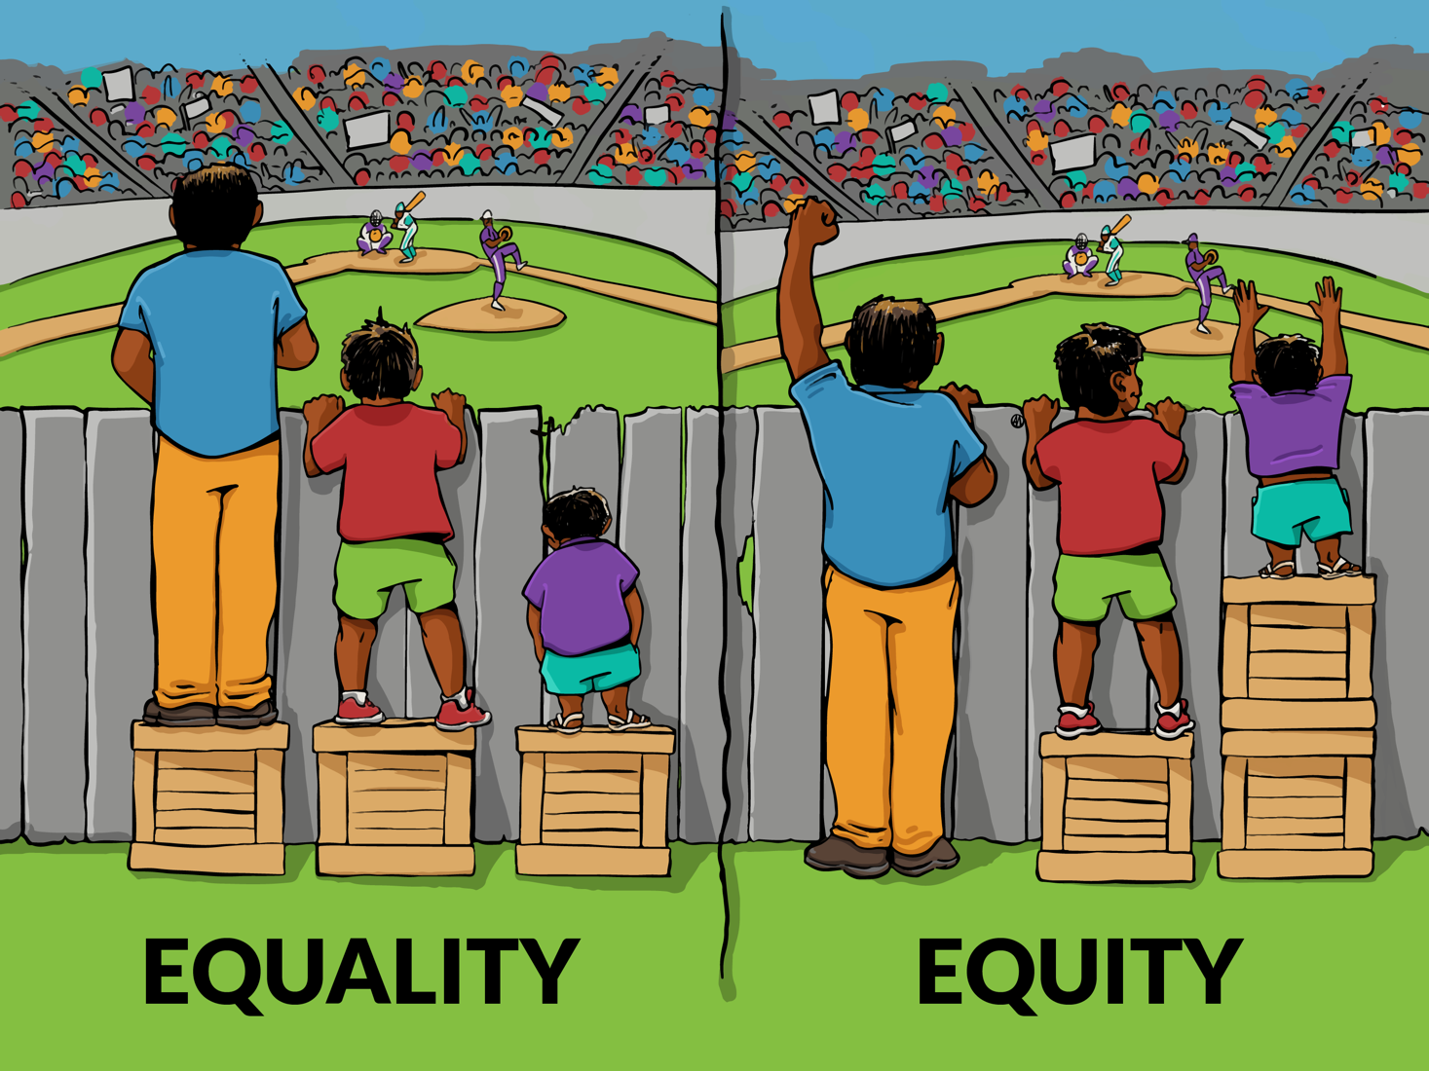
What is the root cause?
THIS!
NOT THIS!
Image: Paul Kutner, 2016
SMFM, 2020
Artist: Angus Maguire

Slide 14
Jedi Public Health
“Less considered in health disparities research is the fact that the exact same setting can be experienced differently by members of different social identity groups, with more positive or adverse effects on different populations.”
(Geronimus et al, 2016)
Image: Kristen Uroda

Slide 15
The Groundwater Approach
(Hayas-Greene & Love, 2018)

Slide 16
How does Healthcare Contribute to Disparities?
Health care system factors
Quality of care and quality improvement
Payment reform systems
Patient-clinician interactions
Stereotype, bias, and stigma
Clinical decision making
Role of patient preferences
(Wasserman et al., 2019)

Slide 17
Link Root Causes with Action
What small modifications we can make right now?
Events What happened?
What changes can we make in policies and practices?
Patterns What continues to happen?
How can we transform systems and structures?
Structures What causes the pattern to be maintained?
(McLemore, 2021; Ogden, 2011)
Notes:
The lens we use to understand root causes sets the stage for how we develop solutions. Whenever we explore root causes one of our goals should be to discover solutions by identifying factors that increase and decrease inequities.
Root causes can be overwhelming! As we dig deeper the problems become larger, more systemic and more engrained. However we’re not uncovering root causes so we can pat ourselves on the back – we want to address them.
This iceberg model is based on model shared by the Interaction Institute for Social Change and helps to identify points of leverage when exploring root causes. Across events, patterns and structures there are linkages – each event has it’s patterns and structures.
By breaking these into categories we may be able to also apply Monica McLemore’s conceptual framework for identifying structural determinants of health, resolving health disparities, and achieving health equity through interventions that retrofit (small modifications we can make right now), reform (changes in policies and practices), and reimagine (revolutionary shifts in systems). McLemore points out that while we all want to be on “team reimagine,” work is needed across all three domains and the work that we do to retrofit or reform can contribute to the eventual establishment of a reimagined healthcare system. This may help to make our work less daunting.
******
https://interactioninstitute.org/undoing-racism-by-design/
https://interactioninstitute.org/the-system-is-us/
- Iceberg with events, patterns and structures
https://www.slideegg.com/blank-iceberg-template

Slide 18
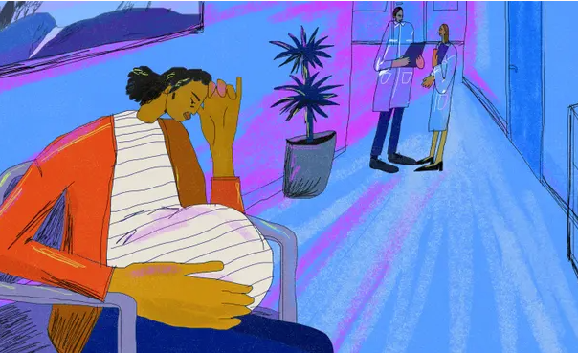
It is Easier to Measure Race than Racism
Notes:
Part of why it’s easier to measure race than racism is because we’ve been doing it for a long time. Since race as we know it came to be race data has been used to define racial differences and perpetuate racism. We live in a racialized society where the minute we see someone we associate them with a racial group but it’s a lot harder to look around our hospitals, our schools and our communities and identify all of the racism that permeates the air.
Dr. Camara Jones points out that “race-associated differences in health outcomes are routinely documented in this country yet for the most part their basis remains poorly explained.” She goes on to discuss how in our racialized society in many ways race is used as a proxy for racism, however racism manifests in many forms. We need to better understand, measure and address those multiple and constantly evolving forms if we hope to address them.
*****
Is race a proxy for racism – yes, but racism manifests in so many forms.
So it’s not surprising that we’ve become accustomed for us use race as a rough proxy for racism
https://www.theguardian.com/commentisfree/2019/may/02/pregnant-black-racial-disparities-maternal-health
Camara Jones
https://academic.oup.com/aje/article/154/4/299/61900
Race-associated differences in health outcomes are rou
tinely
documented in this country (1–4), yet for the most
part their basis remains poorly explained. Instead of vigor
ously
investigating the basis of these differences, we tend to
simply adjust for race in our analyses or restrict our studies
to a single “racial” group
race is generally thought to measure some
combination of social class, culture, and genes. Yet race is only a rough proxy for each of these
That is, race is a social classification in our race-conscious
society that conditions most aspects of our daily life experi
ences
and results in profound differences in life chances
Is race a proxy for racism – yes, but racism manifests in so many forms.

Slide 19
Negative Societal Views: Historical and contemporary negative and false representations of Black people that create and perpetuate damaging stereotypes
Housing:
Systemic laws and supports used to discriminate against Black individuals and families in finding adequate housing in safe and resourceful neighborhoods
Black Women’s Perspectives on Structural Racism
Medical Care:
Racial inequities in access to and engagement in adequate reproductive health care
Law Enforcement: Racial inequities in the number and type of interactions with police officers
Hidden Resources:
Lack of knowledge of availability of community resources and programs addressing women’s health issues.
(Chambers et al., 2021)
Employment:
Unequal employment opportunities and support for Black women and families
Education:
Education system explicitly and implicitly designed to create and sustain racial inequities in disciplinary acts and access to resources in the school system
Policing Black Families:
Direct and indirect monitoring of Black women and children in public and private spaces
Community Infrastructure:
Racial inequities in community assets and deficits
Notes:
On this slide are the 9 domains of structural racism that emerged from a study conducted by Chambers and colleagues.
They conducted focus groups with 32 Black women, the majority of which were either pregnant or postpartum.
The definitions of structural racism that emerged focused on:
The accumulated effect of historic oppression
Laws and processes that are oppressive
Unequal access to resources – such as education, medical care, safe neighborhoods and opportunities
They called systemic racism a silent opportunity killer.
Often when we work within hospital systems and try to find the root causes of pregnancy related health inequities, we search for our specific role. We want to figure out what specific thing are we doing that’s contributing to the problem. That is absolutely necessary. And yet, we also have to go beyond our walls and appreciate that even if we don’t have a direct hand in causing some of these problems we do have a responsibility to raise awareness about them and partner with communities to address them.
This research is also a reminder that we have to partner with Black people to understand how structural racism impacts their health and we have track and address these impact of these factors.

Slide 20
Nanotechnology in the Pharmaceutical Industry
A scientific paper on discoveries in
biomedical research and development
(Massachusetts Department of Health, 2020)
Notes:
To better grasp the full picture we can use instruments such as this one works backwards to trace the downstream and upstream issues that contribute to the inequity. A tool like this can only be completed when multiple stakeholders across a range of sectors are present with representatives of the groups that experience the disparity leading the way.
https://www.mass.gov/doc/racial-equity-data-road-map-pdf/download

Slide 21
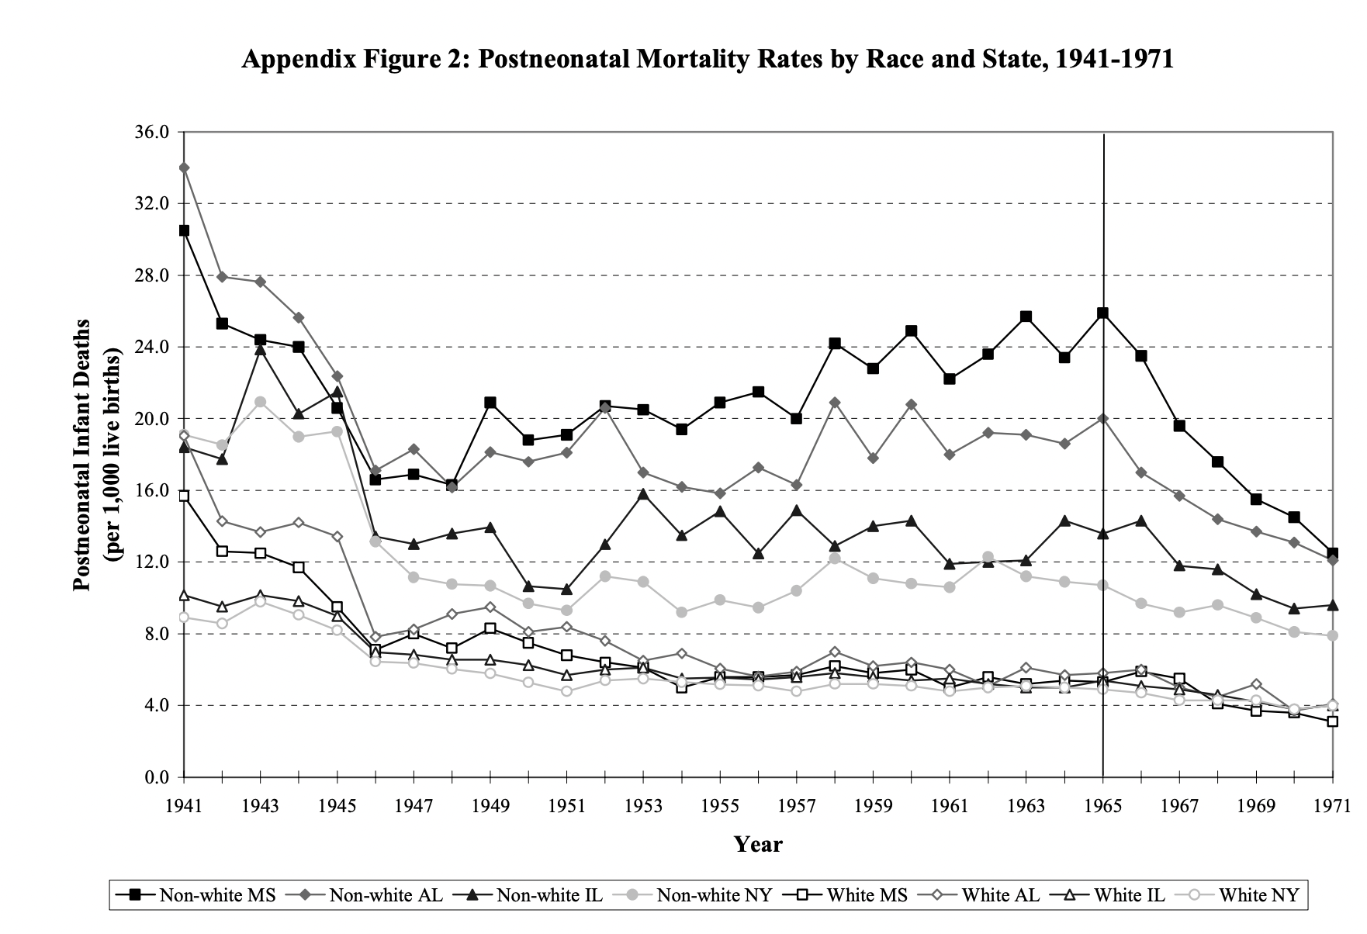
(Almond & Chay 2006)
Notes:
This chart shows postneonatal mortality rates by race for black and white babies in Mississippi, Alabama, Illinois and new York. The bottom lines all represent mortality for white babies. The top 4 lines are for black babies. And you can see that in each state there was a significant drop in mortality for black babies with the deepest slopes in the southern states of Mississippi and Alabama. This drop coincides with the passage of the 1964 civil rights act. We know that Neonatal mortality is associated with the overall health of a community. This graph is a reminder that justice is an essential ingredient to move us towards health equity
****
Need to think about the root causes of good things!
https://users.nber.org/~almond/chay_npc_paper.pdf
POSTNEONATAL MORTALITY RATE is the number of resident newborns dying between 28 and 364 days of age in a specified geographic area (country, state, county, etc.) divided by the number of resident live births for the same geographic area (for a specified time period, usually a calendar year) and multiplied by 1,000

Slide 22
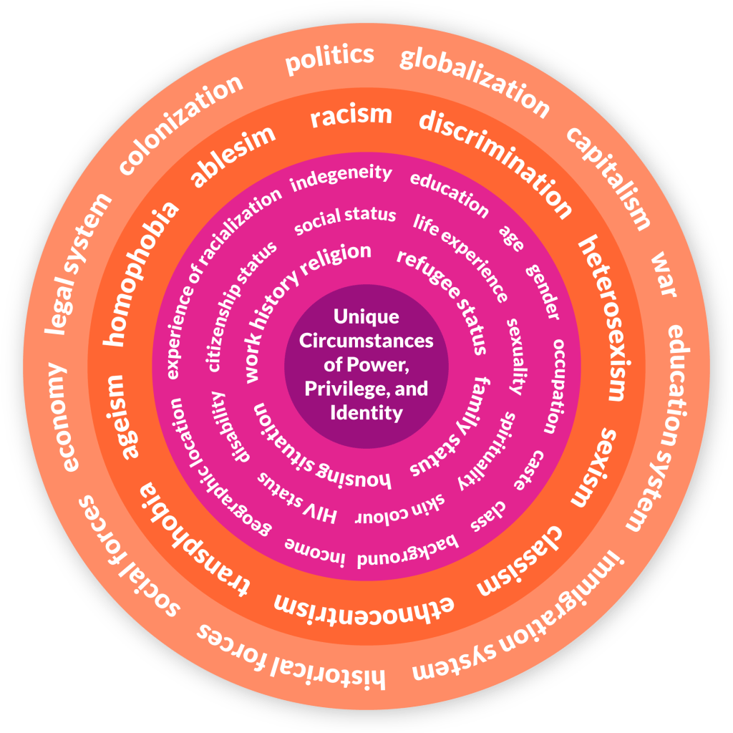
Continue to Expand Measures
New understanding
of the problem
Structural racism
Obstetric racism
Patient experience
Process measures
Patient reported outcome measures
Narrative reports
UNCOVERED KEY RESEARCH TRENDS
Presentations are communication tools that can be used as demonstrations, lectures, speeches, reports, and more.
(Women Friendly Cities Challenge, n.d.)
Notes:
How we explore and frame root causes lays a critical foundation for the solutions we develop and for how we track our progress. And thankfully there is a growing movement to measure the problem – racism, oppression, sexism etc in new and creative ways.
This starts with working to appreciate and understand the unique experiences of each individual across spectrums of intersecting identities. We have so many opportunities to enhance our understanding of the root causes
****
https://womenfriendlycitieschallenge.org/intersectionality/
Deconstructing Inequities — Transparent Values
in Measurement and Analytic Choices
https://www.nejm.org/doi/full/10.1056/NEJMms2035717
People have multiple identities related to defined
geographies, races, ethnic backgrounds, educational
attainment levels, income classes, genders,
sexual orientations, and abilities, among other
variables. Since we thus belong to multiple socially
constructed groups simultaneously, achieving
equity requires addressing multiple dimensions
of disparity.25 Different dimensions may be
more important to different people in measuring
inequality. Ideally, an equity-focused approach to
capturing differences in health between and
within populations26 would drill down to as many
subgroups as possible to capture unique context
and experiences — assessing health, for instance,
among high-income, Asian, nonbinary people,
or those who identify as White women and live
in lower-income metropolitan communities.
A caveat for this approach, however, is that
the relevant data may be unreliable or entirely
unavailable. Slicing the data to uncover layered
identities increases the chances of missing or
unreliable data and reduces the statistical power
for detecting differences.
Center to the margins - https://www.mass.gov/doc/racial-equity-data-road-map-pdf/download
To center to the margins is to shift the focus from the advantaged group's perspective, which is the usual approach, to that of the marginalized group or groups. Should languages spoken be considered? • Would sexual orientation or gender identity expression influence the interpretation of the population of interest? • How might socioeconomic status influence or inform the understanding of the data? • What other factors raised by our community members or specific to our work would inform our understanding of the data?

Slide 23
THANK YOU!

Slide 24
References
Almond, D., & Chay, K. Y. (2006). The long-run and intergenerational impact of poor infant health: Evidence from cohorts born during the civil rights era. University of California-Berkeley, mimeograph. https://users.nber.org/~almond/chay_npc_paper.pdf
Chambers, B. D., Arega, H. A., Arabia, S. E., Taylor, B., Barron, R. G., Gates, B., Scruggs-Leach, L., Scott, K. A., & McLemore, M. R. (2021). Black Women's Perspectives on Structural Racism across the Reproductive Lifespan: A Conceptual Framework for Measurement Development. Maternal and child health journal, 25(3), 402–413. https://doi.org/10.1007/s10995-020-03074-3
Geronimus, A. T., James, S. A., Destin, M., Graham, L. A., Hatzenbuehler, M., Murphy, M., Pearson, J. A., Omari, A., & Thompson, J. P. (2016). Jedi Public Health: Co-creating an Identity-Safe Culture to Promote Health Equity. SSM - population health, 2, 105–116. https://doi.org/10.1016/j.ssmph.2016.02.008
Hayes-Green, D. & Love, B. P. (2018) The groundwater approach: building a practical understanding of structural racism. The Racial Equity Institute. https://static1.squarespace.com/static/578fa7e3d482e9af82f8f507/t/5c1b08a50ebbe8eec9f38d21/1545275564106/REI+Groundwater+Approach.pdf
Massachusetts Department of Health. (2021). Racial Equity Roadmap. https://www.mass.gov/doc/racial-equity-data-road-map-pdf/download
McLemore, M. R. (2021, May 11). Retrofit, Reform, and Reimagine: A Conceptual Framework to Identify Structural Determinants of Health, Resolve Health Disparities, and Achieve Health Equity. presented at: 14th Annual Symposium Social Determinants of Health Johns Hopkins Center for Women’s Health, Sex and Gender Research. https://www.youtube.com/watch?v=0gq97JhFG48
Ogden, C. 2011. The system is us. Interaction Institute for Social Change. https://interactioninstitute.org/the-system-is-us/
Wasserman, J., Palmer, R. C., Gomez, M. M., Berzon, R., Ibrahim, S. A., & Ayanian, J. Z. (2019). Advancing health services research to eliminate health care disparities. American journal of public health, 109(S1), S64-S69.
Women Friendly Cities Challenge. (N.D.) Intersectionality displayed as a wheel diagram. https://womenfriendlycitieschallenge.org/intersectionality/

